Slide 1

OVERCOMING OVERLOAD I

Slide 2

MATTHEUS 11:28-30
Kom na My toe, almal wat vermoeid en belas is, en Ek sal julle rus gee. Neem my juk op julle en leer van My, want Ek is sagmoedig en nederig van hart, en julle sal rus vind vir julle siele; want my juk is sag en my las is lig.
Jesus

Slide 3
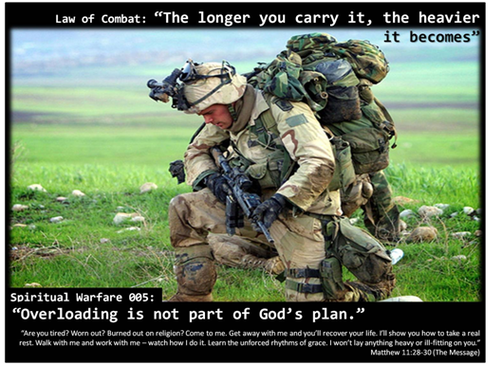

Slide 4
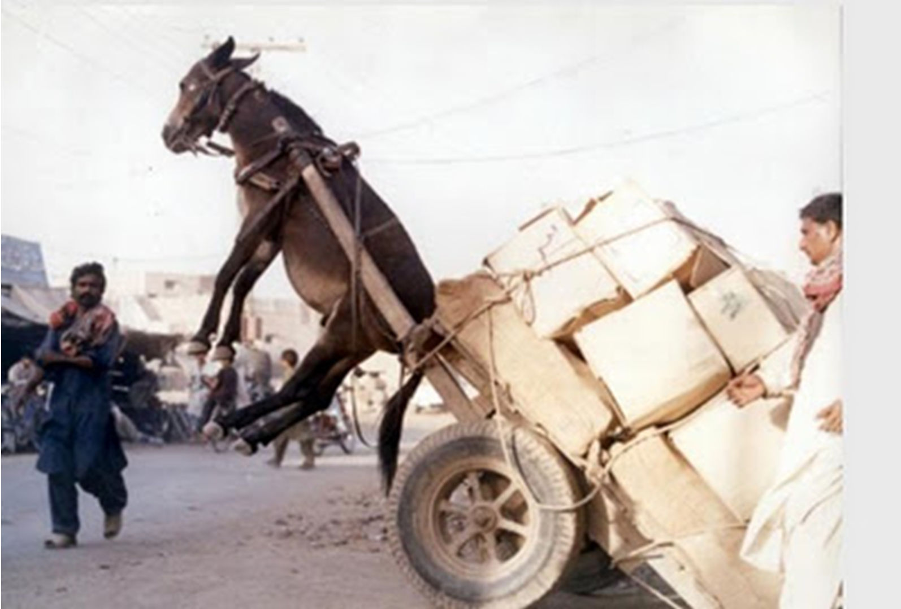

Slide 5
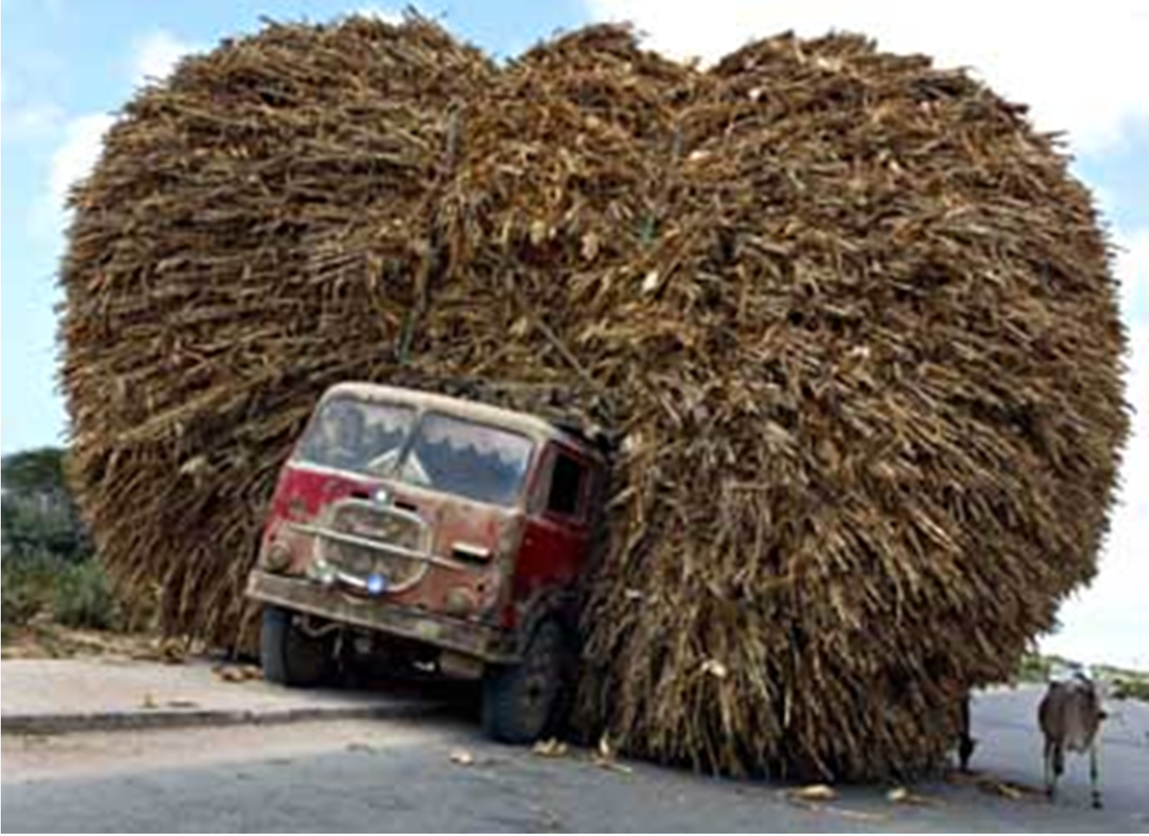

Slide 6
OVERCOMING OVERLOAD I
‘Because we are running our lives in such a deficit we get overdrawn and overloaded and run out of currency – the emotional, relational and spiritual ‘cash’ that it takes to live life well.’

Slide 7
OVERCOMING OVERLOAD I
’Philosophy says: Be sensous; enjoy yourself, Educations says: Be resourceful, expand yourself, Materialism says: Be satisfied; please yourself, Psychology says: Be confident fulfil yourself, Pride says: Be superior, promote yourself, Humanism says: Be capable; believe in yourself, but God says: Be wise, humble yourself and receive the truth.’

Slide 8
OVERCOMING OVERLOAD I
To OVERCOME OVERLOAD you need a…
SABBATH,

Slide 9
OVERCOMING OVERLOAD I
To OVERCOME OVERLOAD you need a…
SABBATH,
SANCTUARY,

Slide 10
OVERCOMING OVERLOAD I
To OVERCOME OVERLOAD you need a…
SABBATH,
SANCTUARY,
SUSTENANCE,

Slide 11
OVERCOMING OVERLOAD I
To OVERCOME OVERLOAD you need a…
SABBATH,
SANCTUARY,
SUSTENANCE,
SUPPLICATION,

Slide 12
OVERCOMING OVERLOAD I
To OVERCOME OVERLOAD you need a…
SABBATH,
SANCTUARY,
SUSTENANCE,
SUPPLICATION,
SIMPLIFY,

Slide 13
OVERCOMING OVERLOAD I
To OVERCOME OVERLOAD you need a…
SABBATH,
SANCTUARY,
SUSTENANCE,
SUPPLICATION,
SIMPLIFY,
SOVEREIGN,

Slide 14
OVERCOMING OVERLOAD I
To OVERCOME OVERLOAD you need a…
SABBATH,
SANCTUARY,
SUSTENANCE,
SUPPLICATION,
SIMPLIFY,
SOVEREIGN,
SAVIOR.

Slide 15
OVERCOMING OVERLOAD I
Overloaded people needs words that begins with ‘re’. Words like restore, revive, recover, recline, reflect, relax, replenish and renew. These words appeal to us because they seem so foreign to our daily experience. The first principle God has given to us for overcoming overload is the principle of the Sabbath which will bring all these things into our lives and more.

Slide 16
OVERCOMING OVERLOAD I
‘God created the world in six days and then rested on the seventh. He didn’t rest because He was tired. He did it as an example for us. God gave us a day off to protect us from overload. He designed it as a day to restore us – spiritually, mentally, emotionally and physically.’
Steve Farrar

Slide 17
OVERCOMING OVERLOAD I
SANCTUARY.

Slide 18
OVERCOMING OVERLOAD I
In DRIE DIMENSIES –
SOLITUDE, SILENCE, STILLNESS.

Slide 19
MATTHEUS 14:22-23
En Jesus het dadelik sy dissipels gedwing om in die skuit te gaan en voor Hom uit te vaar na die oorkant, terwyl Hy die skare wegstuur. En nadat Hy die skare weggestuur het, klim Hy op die berg om in die eensaamheid te bid. En toe dit aand geword het, was Hy daar alleen.

Slide 20
MARKUS 1:35-36
En vroeg in die môre, nog diep in die nag, het Hy opgestaan en uitgegaan en na ‘n eensame plek vertrek en daar gebid. En Simon en die wat by hom was, het Hom gevolg.

Slide 21
PSALMS 62:2 & 6
Ja, my siel is stil tot God; van Hom is my heil…Wees net maar stil tot God, my siel, want van Hom is my verwagting!

Slide 22
PSALMS 46:10
Be STILL and know that I am God…

Slide 23
OVERCOMING OVERLOAD I
SUSTENANCE.

Slide 24
MATTHEUS 4:4
Die mens sal nie van brood alleen lewe nie, maar van elke woord wat deur die mond van God uitgaan.

Slide 25
The believer is bred by the Word and therefore must be fed by it.

Slide 26
2 TIMOTHY 4:3-4
People will have no stomach for solid teaching, but will fill up on spiritual junk food – catchy opinions that tickle their fancy. They’ll turn their backs on truth and chase illusions.

Slide 27
OVERCOMING OVERLOAD I
William Hunter was only 15 years old when he was burned at the stake in 1555. William had a great hunger for Jesus Christ and a powerful desire to know His Word. But in the England of 1555, ordinary people were not allowed to have Bibles. The priests withheld the Scriptures from the ‘commoners’ as they were called. Other than the Bible chained to the altar at church, there wasn’t a single copy of the Scriptures in William’s village.

Slide 28
OVERCOMING OVERLOAD I
Here was a young teenage boy who would have given anything to have just one Bible. But the Roman Catholic Church didn’t want people reading the Bible. William became so hungry to read the Bible that he walked into a church, opened the pages of the chained Bible, and began to read. An official of the church walked in and scolded him for having the cheek to read the Bible by himself.

Slide 29
OVERCOMING OVERLOAD I
Shortly thereafter, a warrant for his arrest was issued and he was taken from his family, wrapped in chains and thrown into a dungeon for nine months. He was then put on trial and given the opportunity to recant his evil deed – daring to read the Bible. The local bishop offered him forty pounds and enough capital to start his own business if he would recant. William refused, knowing full well that he would die in the fire.

Slide 30
OVERCOMING OVERLOAD I
As he was chained to the stake, with the dry wood all around him, he was again given a chance to recant. Again he refused and then he turned to the crowd asking them to pray for him. A judge the called out to him: I will no more pray for you than I would pray for a dog! The fire was then lit and the flames engulfed the brave young man. His last words were: ‘Lord Jesus, receive my spirit.’

Slide 31
OVERCOMING OVERLOAD

