Slide 1

THE GOSPEL OF THE KINGDOM VI
Notes:
Font: Century Gothic
Main Title Slide: Font Size 80
Main Headings: 40-44
Main Body: 33
Bold and Italic as required
Spacing: 15
Verse numbers: 20
Hebreërs
Matthéüs
Timótheüs
Korinthiërs
Efésiërs
Númeri

Slide 2

TEAM ASSESSMENT FOR JESUS.
To: Jesus, son of Joseph, Woodcrafter, Carpenter Shop, Nazareth, Israel.
From: Jordan Personnel Management Consultants. CC.

Slide 3
Dear Sir, Thank you for submitting resumes of the Twelve men you have chosen for critical leadership positions in your new organization. All of them have thoroughly gone through our qualified battery of tests.

Slide 4
We have not only run the results through our computerized system, but also arranged personal interviews for each of them with our clinical and sociological psychologists as well as two vocational aptitude consultants. It is our staffs' unanimous opinion that most of your nominees are lacking in background, education and vocational aptitude for the type of enterprise you plan to undertake.

Slide 5
They do not have the team concept. We recommend that you continue your search for alternative persons who at least have the kind of experience that you are looking for, men with management ability and proven capability. For example: Simon Peter is unstable and given to fits of temper. Andrew has absolutely no leadership qualities. The two brothers, James & John, sons of Zebedee, place personal interest above company loyalty. Thomas demonstrates a questioning attitude that would tend to undermine morale.

Slide 6
We feel it is our duty to tell you that Matthew has been blacklisted by the Greater Jerusalem Better Business Bureau. James, the son of Alpheus and Thaddeus definitely have radical convictions and they registered a high score on the manic-depressive scale. Simon the Zealot, admit that he was involved with terrorist activity. His sentiments and convictions would blow apart the harmony of any team.

Slide 7
One of the candidates, however, shows great potential. He has a keen business mind, meets people well and has contacts in high places. He's ability as motivational speaker is a cut above the rest and with his compassionate nature and smooth talk would be able to put out any conflict that threatens the future of the team. He's ambitious and have a doctorate degree from one of our best Universities. We therefore highly recommend Judas Iscariot as your second IC and right-hand man. All of the other profiles are self-explanatory.

Slide 8
We wish you every success in your new venture.
Sincerely yours,
JORDAN MANAGEMENT CONSULTANTS.

Slide 9
Lukas 6:12-16
En Hy het in daardie dae uitgegaan na die berg om te bid en die nag in die gebed tot God deurgebring. En toe dit dag geword het, het Hy sy dissipels na Hom geroep en twaalf van hulle uitgekies, wat Hy apostels genoem het: Simon wat Hy Petrus genoem het, en Andréas, sy broer; Jakobus en Johannes; Filippus en Bartholoméüs; Matthéüs en Thomas; Jakobus, die seun van Alféüs, en Simon wat Yweraar genoem word; Judas, die seun van Jakobus, en Judas Iskáriot, wat die verraaier geword het.

Slide 10
Mattheus 20:17-24
En toe Jesus opgaan na Jerusalem, het Hy die twaalf dissipels op die pad alleen geneem en vir hulle gesê: Kyk, ons gaan op na Jerusalem, en die Seun van die mens sal oorgelewer word aan die owerpriesters en skrifgeleerdes; en hulle sal Hom tot die dood veroordeel en Hom oorlewer aan die heidene om Hom te bespot en te gésel en te kruisig; en op die derde dag sal Hy opstaan.

Slide 11
Mattheus 20:17-24
Toe kom die moeder van die seuns van Sebedéüs met haar seuns na Hom en buig voor Hom neer om iets van Hom te vra. En Hy sê vir haar: Wat wil jy hê? Sy antwoord Hom: Sê dat hierdie twee seuns van my in u koninkryk mag sit, een aan u regter - en een aan u linkerhand.

Slide 12
Mattheus 20:17-24
Maar Jesus antwoord en sê: Julle weet nie wat julle vra nie. Kan julle die beker drink wat Ek aanstons gaan drink, en gedoop word met die doop waarmee Ek gedoop word? Hulle sê vir Hom: Ons kan.

Slide 13
Mattheus 20:17-24
En Hy sê vir hulle: Dis waar, my beker sal julle drink en met die doop waarmee Ek gedoop word, sal julle gedoop word; maar om te sit aan my regter - en aan my linkerhand berus nie by My om te gee nie, maar is vir hulle vir wie dit deur my Vader berei is. En toe die tien dit hoor, was hulle verontwaardig oor die twee broers.

Slide 14
Johannes 21:17-19
Hy vra hom die derde maal: Simon, seun van Jona, het jy My lief? Petrus het bedroef geword, omdat Hy hom die derde maal vra: Het jy My lief? En hy antwoord Hom: Here, U weet alles, U weet dat ek U liefhet. Jesus sê vir hom: Laat my skape wei.

Slide 15
Johannes 21:17-19
Voorwaar, voorwaar Ek sê vir jou, toe jy jonger was, het jy jouself gegord en rondgegaan waar jy wou; maar wanneer jy oud geword het, sal jy jou hande uitsteek, en 'n ander een sal jou gord en bring waar jy nie wil wees nie. En dit het Hy gesê om aan te dui deur hoedanige dood hy God sou verheerlik; en toe Hy dit gespreek het, sê Hy vir hom: Volg My.

Slide 16
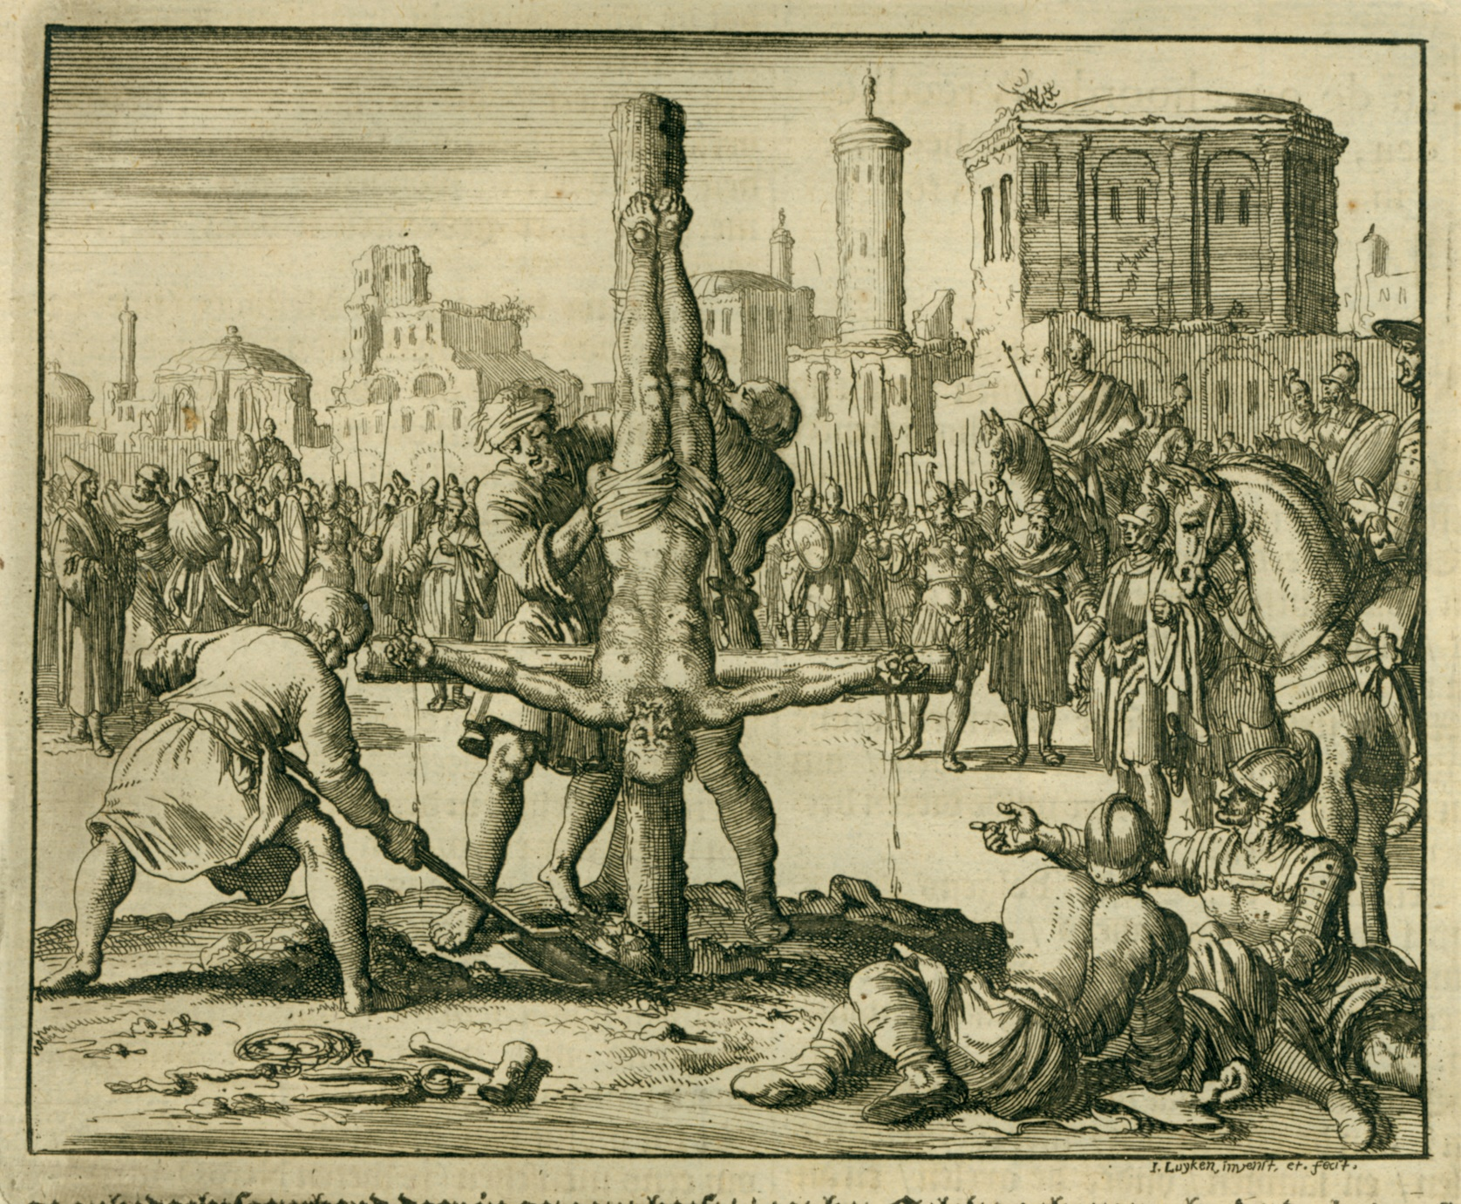
SIMON PETER

Slide 17
SIMON PETER
The most prominent of the twelve disciples in the Gospels and an outstanding leader in the Early Church, Peter was a native of Bethsaida and the son of a certain John. Along with his brother Andrew they followed the hardy occupation as fishermen on the Sea of Galilee, being partners with the Zebedee family and the two brothers James and John. He was married and at the time of Jesus' Galilean ministry lived in Capernaum along the shores of Galilee. In Acts Peter is considered as one of the pillars of the church in Jerusalem.

Slide 18
SIMON PETER
He was once taken into custody under Herod, the church offered prayer and he was miraculously released from prison with the help of an angel. According to the record of the Church Historian Hegesippus Peter in his old age eventually travelled to Rome to minister there. Ceasar Nero was determined to have him executed, but his brothers got information about the attempt and urged him to flee the city.

Slide 19
SIMON PETER
Though resistant at first, Peter eventually agreed, but as he approached the city gate he saw a vision of Jesus walking in the opposite direction. It was so real to him that he fell to his knees and asked: 'Lord, where are you going?' He sensed the Lord saying: 'I've come to be crucified again.

Slide 20
SIMON PETER
Peter took this to mean that it was his time to die just as Jesus had prophesied to him years before, so he returned to the city. Upon being captured and sentenced to be crucified with his wife, Peter said that he was not worthy to hang in the same position as his Saviour and requested to be put on the cross upside down. The Romans honoured his plea and they both died a martyr's death for preaching and teaching the Gospel of Jesus Christ their whole lives.

Slide 21
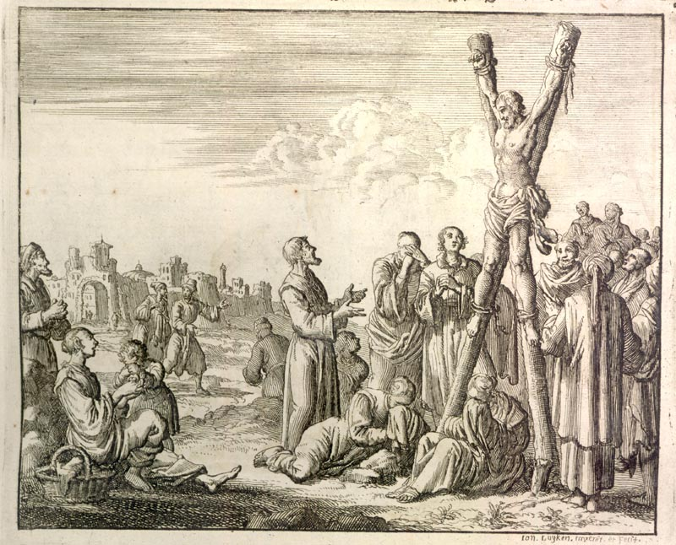
ANDREW

Slide 22
ANDREW
He was the brother of Simon Peter and also made a life as a fisherman on the Sea of Galilee in the North. He was also a disciple of John the Baptist, who directed him to Jesus as the Lamb of God. Convinced that Jesus was the long awaited Jewish Messiah, he quickly brought his brother Peter to Jesus. Subsequently Jesus called the two brothers to abandon their family business and follow Him to become fishers of men.

Slide 23
ANDREW
Andrew was crucified in the city of Sebastopolis at the hand of the Roman Governor Aegeas. He led so many people to Christ that the Governor himself came to visit the province to force new converts to offer to Roman idols and deny their faith in Jesus.

Slide 24
ANDREW
Andrew challenged the Governor in his face by saying he has to repent of his idolatry. In a rage the Governor prohibit Andrew to preach Christ. He threatened him that if he would continue to proclaim Christ, he would be executed. Andrew responded by saying: 'I would not proclaim the glory and the honour of the cross if I feared the death of the cross.' He was sentenced immediately.

Slide 25
ANDREW
While he was taken to the place of execution he saw the cross afar off and called out: 'O wonderful cross, whom I have longed for so often, I come to you willingly, joyfully and with great desire, the disciple of Him who hang on you. I always loved you and long to embrace you.' He hung on the cross for three whole days and instructed all who stood nearby to remain steadfast and faithful. Also to endure in the Word and teaching which they have received, 'that you may dwell with God in eternity and receive the fruit of his promises', he said.

Slide 26
ANDREW
After three days the Christians asked the Governor to take Andrew down from the cross and release him to them. Andrew prayed saying he desire to see God rather than to dwell among men and died shortly after that.

Slide 27
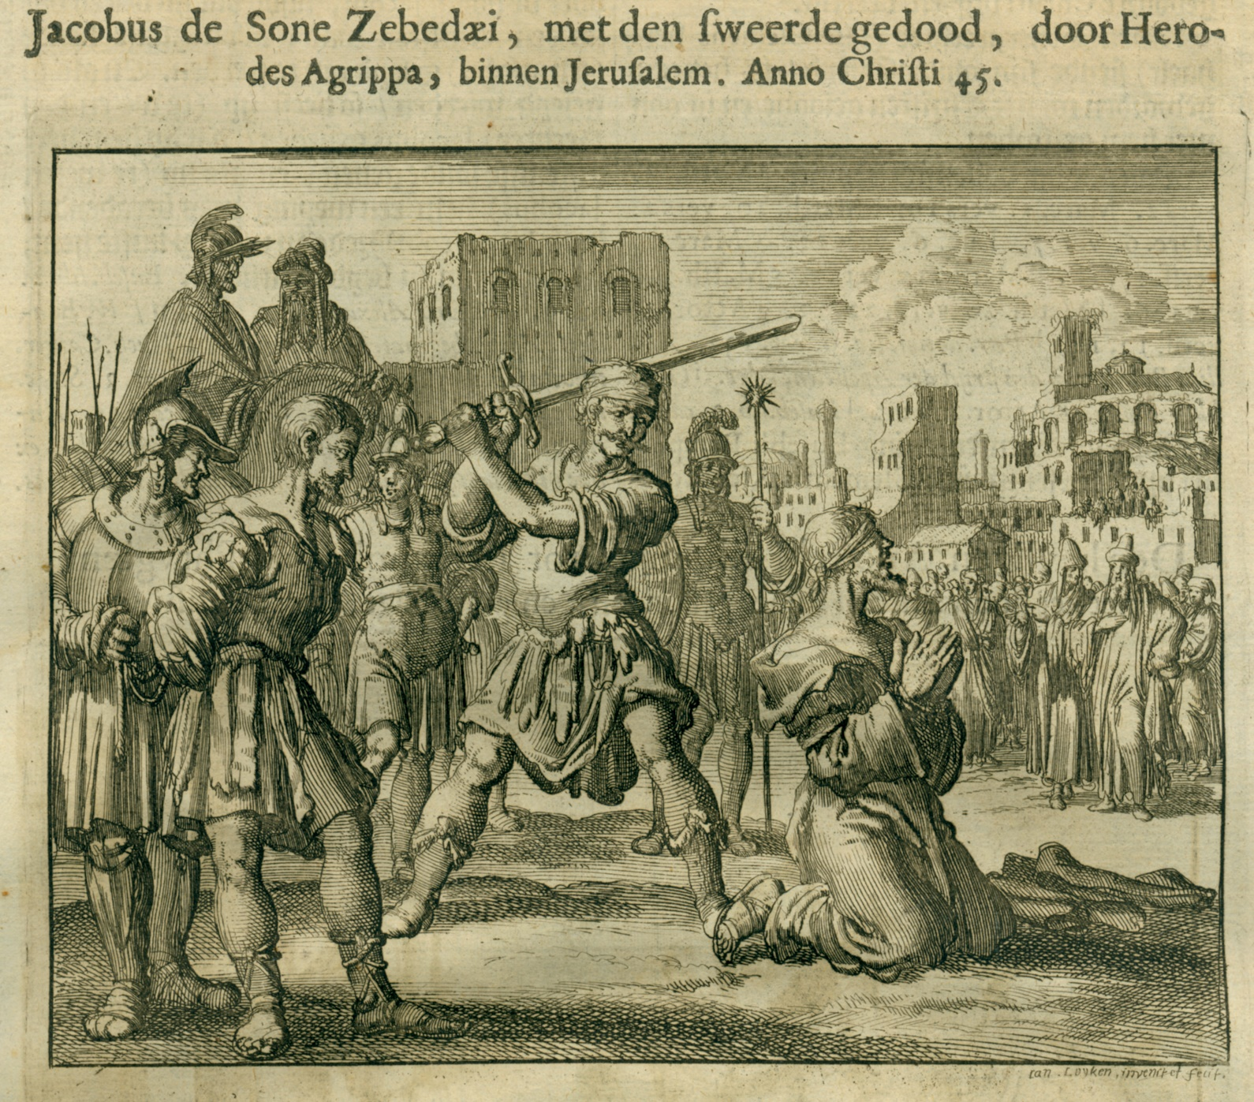
JAMES, SON OF ZEBEDEE

Slide 28
JAMES, SON OF ZEBEDEE
James was also a Galilean fisherman who was called to be one of the original Twelve disciples at the same time as his younger brother John. James, John and Peter became a trio that was closest to Jesus. In AD 44 King Herod Agrippa decided to stop the spread of Christianity by striking its leaders.

Slide 29
JAMES, SON OF ZEBEDEE
He had James arrested and sentenced to death on the basis of one man’s testimony. His death, reported in Acts 12:2 is the only martyrdom of one of the twelve apostles that is recorded in the New Testament. When his accuser saw James’ courage and steadfast joy, even when condemned to die, he made a decision for Christ and asked James forgiveness for what he has done. James forgave him and gave him a holy kiss. Then the man said, 'You should not receive the crown of martyrdom alone. I will die with you.

Slide 30
JAMES, SON OF ZEBEDEE
He was immediately sentenced to death and they were both brought to the place of execution. Minutes later, the two were beheaded together for their faith in Christ.

Slide 31
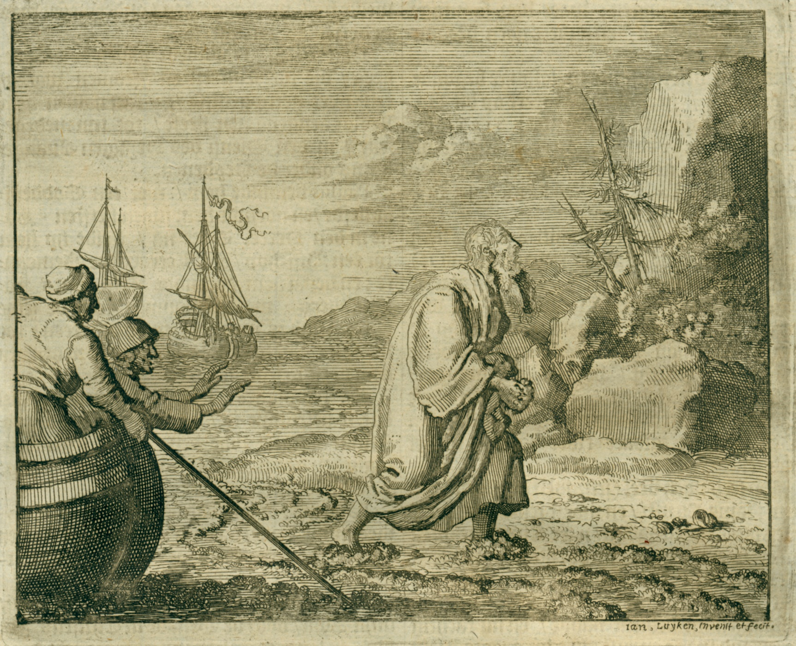
JOHN, SON OF ZEBEDEE

Slide 32
JOHN, SON OF ZEBEDEE
Brother of James, John was also a fisherman from Capernaum. He too was first a disciple of John the Baptist and he tells us in his Gospel how he came to follow Jesus. Mark’s Gospel states that Jesus gave him and his brother the nicknames sons of thunder, evidently because of their abrupt zeal, intensity and bold personalities. John was the last of the twelve apostles to die.

Slide 33
JOHN, SON OF ZEBEDEE
At one stage before a huge crowd, he was put in a vat of boiling oil to execute him. As they lowered him into the pot he prayed and remained harmless in the boiling oil. The plan of the Emperor to mock the Christians by murdering John in this way, backfired and instead of undermining faith in Christ actually helped it to grow. It was then that John was banished to the island of Pathmos where he received the Book of Revelation and was released two years later when the Emperor Domitian died.

Slide 34
JOHN, SON OF ZEBEDEE
He was brought back to Ephesus and continued to minister there. Even then he still suffered persecution and was forced to drink poison but remained unharmed. Church history has very strong evidence that he wrote the Gospel of John here in Ephesus at the request of fellow believers and friends and agreed to do so but only after the church had fasted and prayed about the matter for three days. He read the Gospels of Matthew, Mark and Luke, verified that they were true and then wrote the Gospel of John to add his perspective as well as his three letters.

Slide 35
JOHN, SON OF ZEBEDEE
John the Beloved outlived all of the other apostles by more than thirty years and was the only one of the twelve that did not die an unnatural death. He finally died in peace at the age of 101 after seeing the longest scope of Jesus’ ministry, from the days of John the Baptist until the end of the first century Church.

Slide 36
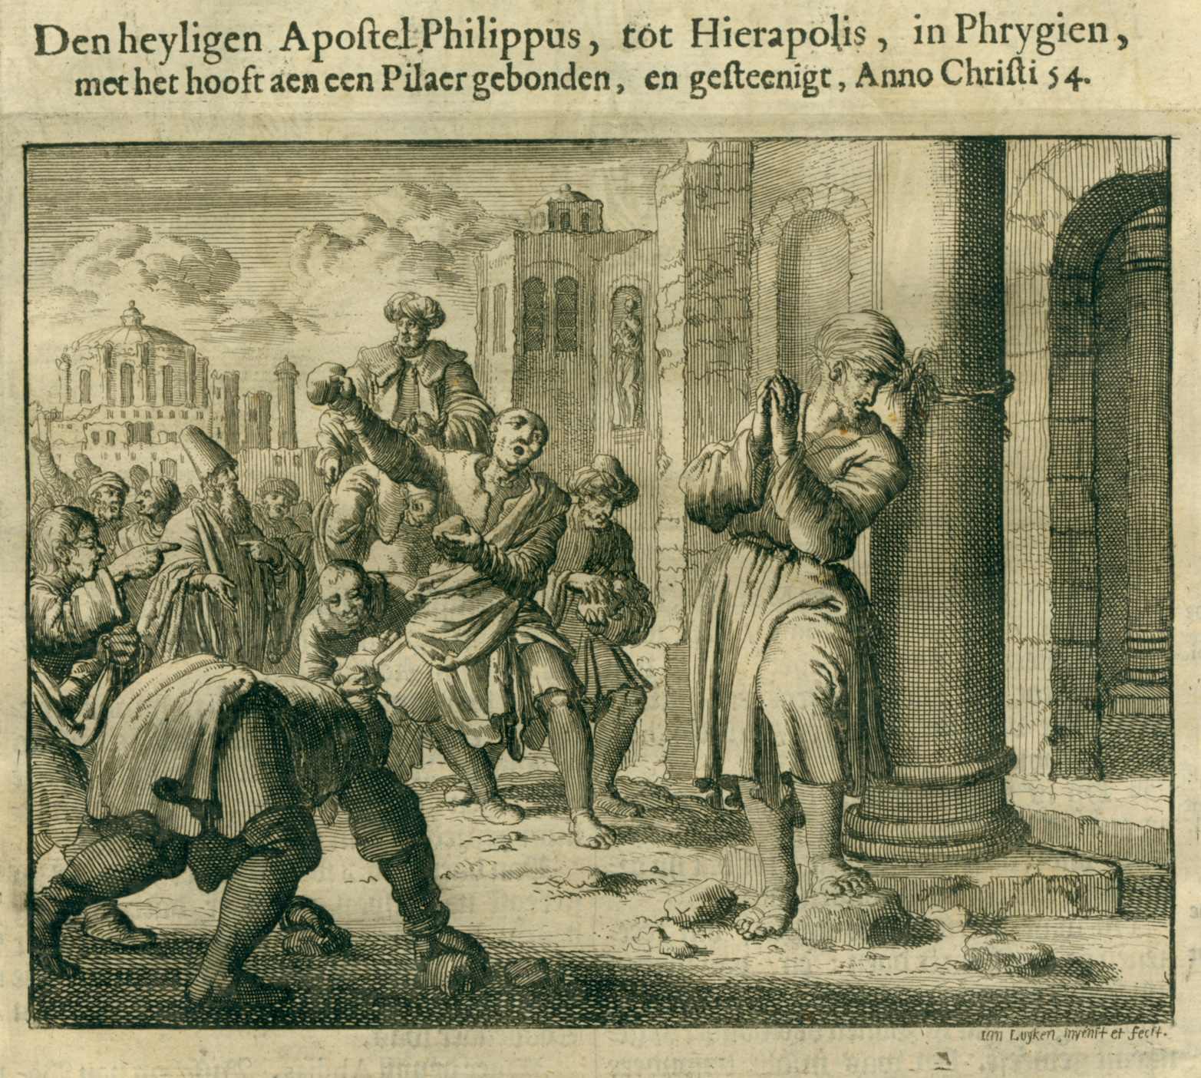
PHILIP

Slide 37
PHILIP
Philip was a native of Bethsaida in Galilee, the city of Andrew and Peter. He is not to be confused with the deacon Philip that became Philip the evangelist in Acts. Jesus met Philip at the side of the Jordan River during the ministry of John the Baptist. Philip brought Jesus to Bartholomew and most of the time we see the two of them mentioned together.

Slide 38
PHILIP
The last mention of Philip is in Acts 1:13 where it is mentioned that he was one of the twelve present in the Upper Room after the resurrection of Jesus. He later evangelized what is today known as Turkey and Syria.

Slide 39
PHILIP
There are two traditions about Philip's death. One simply states that the authorities whipped him, threw him in prison, and later crucified him. The other one has it that Philip was tied to a pillar and stoned to death. He died in AD 51 in Hierapolis and thus becoming the second apostle to be martyred for Christ.

Slide 40
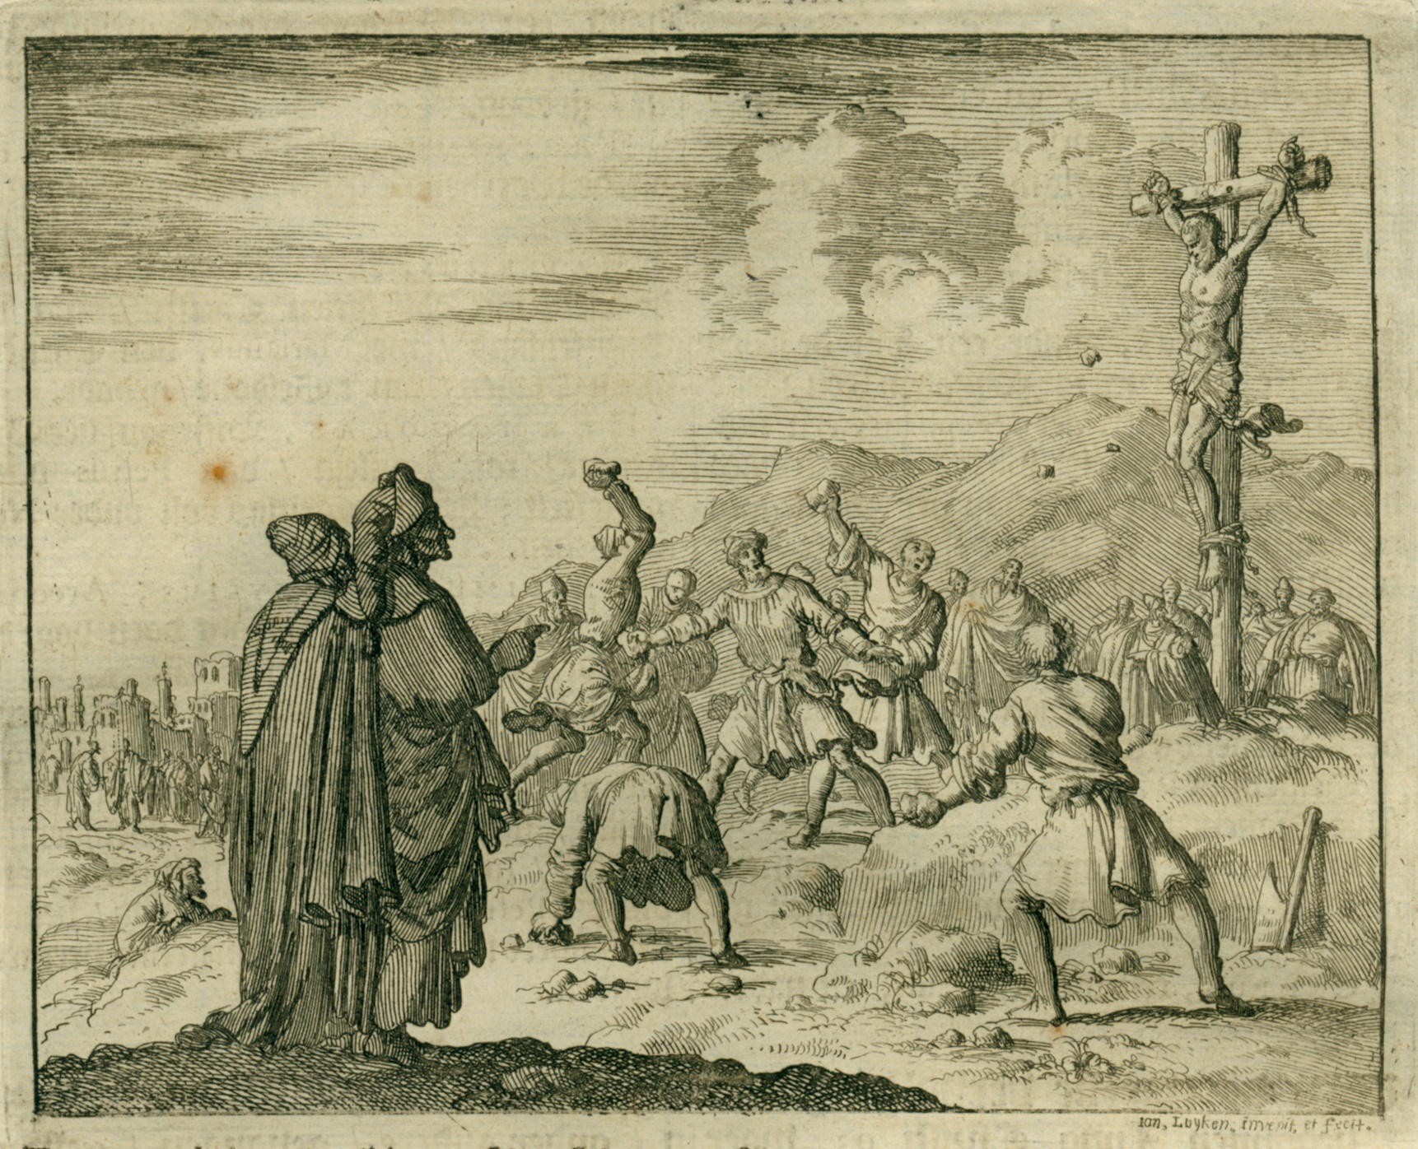
MATTHEW

Slide 41
MATTHEW
Matthew means 'Gift of God', but he was also called Levi. He came from Capernaum and his father’s name was Alphaeus, which possibly makes him the brother of the other James son of Alphaeus. Matthew’s background and talents must have been of great value to Jesus. As a tax-collector he was skilled at writing and keeping records and his Gospel reflects that accuracy. He was also a man of deep spiritual convictions.

Slide 42
MATTHEW
After his conversion he invited his former colleagues to his own house, with Jesus as the guest of honour. Apart from the list of the apostles, no further notices of him is found in the New Testament. Matthew died in Ethiopia under the hand of King Hytacus while being a pastor and teacher there. The King had him arrested while he stood teaching the church. He was dragged outside, nailed to the ground with short spears, and beheaded. Another tradition has it that he was also simply crucified. The year was AD 66.

Slide 43
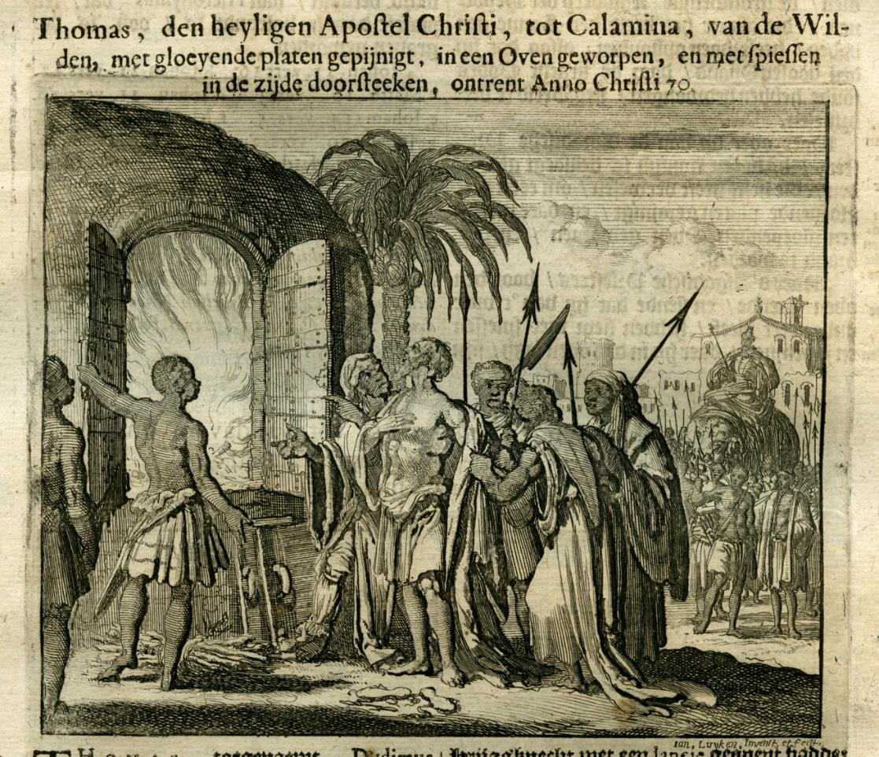
THOMAS

Slide 44
THOMAS
One of the Twelve, Thomas was also called Didymus or the Twin. Labelling him 'doubting Thomas' for his apparent unbelief is a gross misunderstanding of who he really was. Most of us is unfamiliar with his words in John 11 when he said, after hearing the news of Lazarus’ death, 'Let us also go, that we may die with Him' (that is Jesus), something that the other disciples was far from ready to do.

Slide 45
THOMAS
Thomas had a teaching gift and simply wanted to verify the facts based on the truth when he asked to put his finger into the nail prints and the scar in Jesus’ side before he threw himself into spreading this Good News. He was also the one that asked Jesus: 'Lord, we do not know where You are going, and how can we know the way?' Upon which Jesus answered; 'I am the way, the truth, and the life. No one comes to the Father except through Me.' Thomas just wanted to make sure.

Slide 46
THOMAS
Jesus though did tell Thomas to believe now that he saw Him, but that those who haven’t seen what he did and yet believe is greatly blessed. Thomas travelled as far as India to preach the Gospel.

Slide 47
THOMAS
Around AD 70 he went to Calamina, India where the people worshipped an image of the sun. He ministered to them and managed to stop their idolatry and serve the living God. The sun god’s priests were furious. They accused him before their king, who sentenced him to be tortured with red-hot metal plates and then thrown into a glowing furnace. To the amazement of all, the fire did not hurt him. The angry priests then threw him with spears that killed him in the fire. He paid the highest price for his faith in Christ.

Slide 48
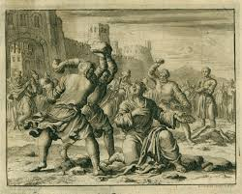
JAMES, SON OF ALPHAEUS

Slide 49
JAMES, SON OF ALPHAEUS
We know from the Gospels that he was the son of Alphaeus and possibly Matthew’s brother. He is mentioned in the list of apostles and is again present when the disciples is waiting in the Upper Room. He is not to be confused with James the Just or James Camel Knees who was the brother of Jesus and wrote the epistle of James. We do not know much more about this James son of Alphaeus except that he too was persecuted and died for Christ.

Slide 50
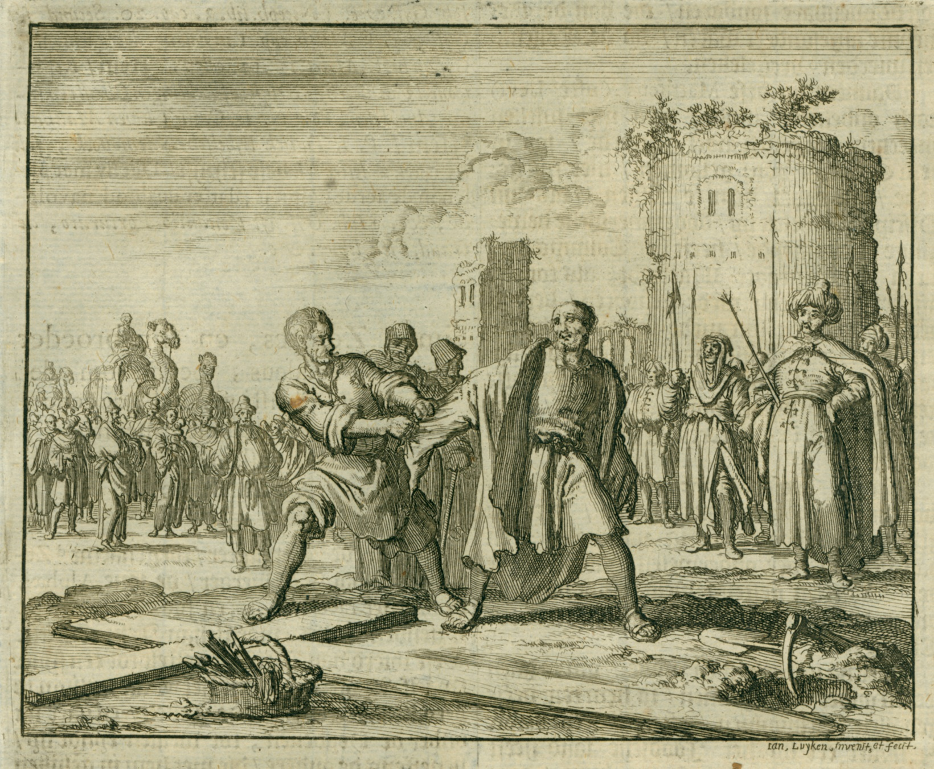
SIMON THE ZEALOT

Slide 51
SIMON THE ZEALOT
Simon Zealot was part of the secret militant political movement called the Sicarri or Zealots who was Jewish revolutionaries who opposed the rule of Rome. Jesus called him to be one of His disciples during this turbulent time in Israel.

Slide 52
SIMON THE ZEALOT
His passion and zeal was then redirected, and he began focusing on delivering all people from the spiritual oppression and rule of satan. He later preached the Gospel in North Africa, Mauritania and the British Isles. It was here that he was painfully tortured and crucified after a lifetime of preaching the Gospel, sealing with his blood his faith.

Slide 53
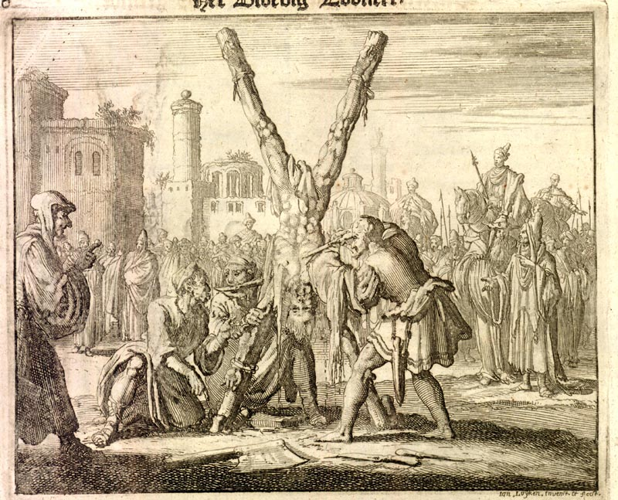
BARTHOLOMEW (NATHANEAL)

Slide 54
BARTHOLOMEW (NATHANEAL)
One of the original Twelve disciples, the Gospel of John identifies Bartholomew as Nathaneal. (Jh 1:45-49), and church fathers uses the names interchangeably. He came from Cana in Galilee. The circumstances surrounding the calling of Bartholomew are somewhat striking, since Christ praises his integrity at their initial encounter. Bartholomew’s knowledge of the Scriptures seems to have been considerable because of the remarkable theological debate that occurred between him and Jesus.

Slide 55
BARTHOLOMEW (NATHANEAL)
After preaching Christ faithfully for 37 years the king of Armenia accused Bartholomew of perverting his brother by accepting Jesus. He told the king that he did not perverted his brother, but rather converted him to the truth. He threatened Bartholomew to stop preaching Christ and offer sacrifices to their God Ashtaroth. He refused. He was severely tortured, crucified upside down and skinned alive.

Slide 56
BARTHOLOMEW (NATHANEAL)
Despite all this, he was still conscious and continued to exhort the people to believe in Jesus and worship the true God. Finally, to prevent him from saying anything else, the king’s men took an axe and cut off his head. Bartholomew was then united with Jesus, his Lord.

Slide 57
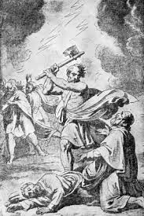
JUDAS THADDAEUS

Slide 58
JUDAS THADDAEUS
One of the Twelve, he was also called Lebbaeus, carefully distinguished from Judas Iscariot. He may have taken the name Thaddeus meaning ‘warm-hearted’ because of the infamy that came to be attached to the name Judas. He is not to be confused with Judas the half brother of Jesus who wrote the epistle of Jude or with Judas Barsabbas that was sent with Silas to help Paul and Barnabas. (Acts 15:22)

Slide 59
JUDAS THADDAEUS
He ministered in countries like Mesopotamia, Syria, Arabia and present-day Iran. There he preached boldly against worshipping idols and making heathen sacrifices. When the pagan priests saw that they were losing followers and income because of Thaddaeus' teaching, they attacked him with sticks and clubs, beating him to death. He died in AD 68 for faith in Christ.

Slide 60
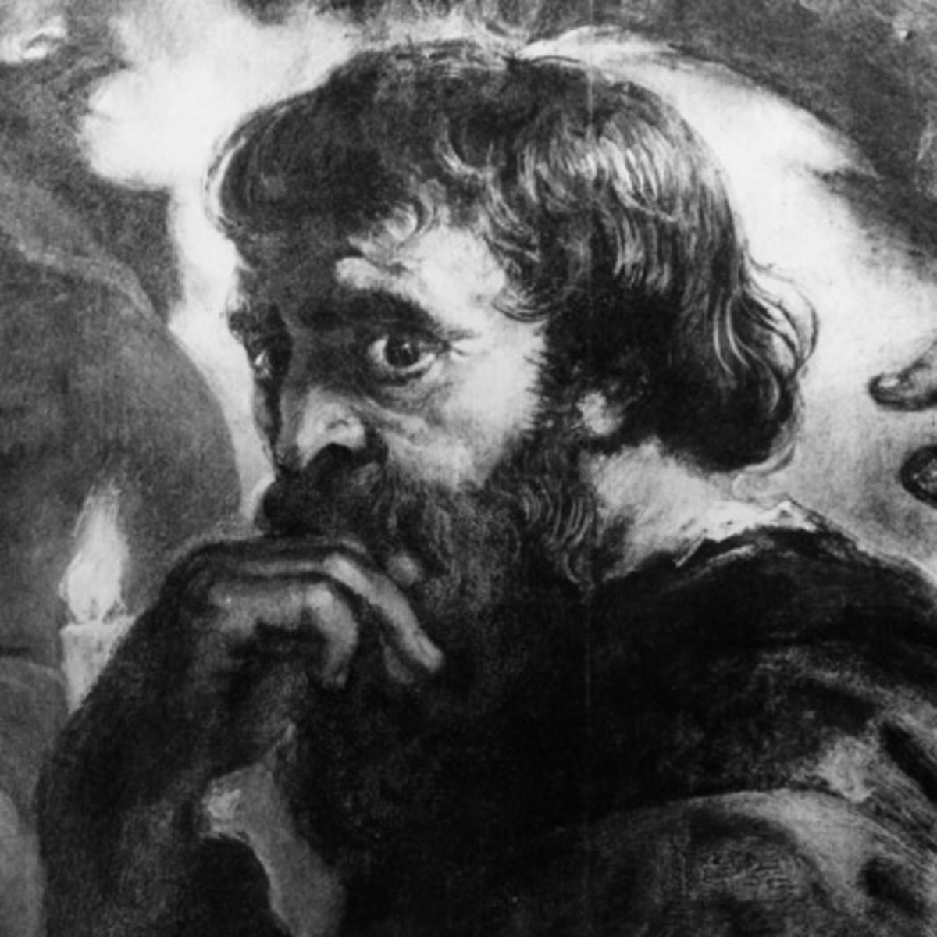
JUDAS ISCARIOT

Slide 61
JUDAS ISCARIOT
Iscariot means from Kerioth, being the only Judean from the South among the Twelve, Judas is always mentioned last among the disciples.

Slide 62
JUDAS ISCARIOT
Judas was called just like all the other, heard and saw everything Jesus said and did, though Jesus always knew what was in his heart. He had all the chance in the world to make the right decisions, but covetousness ruined him. Judas was the treasurer of the apostolic band, but also stole money from their resources. It is not impossible that Judas aspired for a high position in an earthly kingdom of Jesus, but after that hopes were dashed by what Jesus said and done began the downward road to eventually betray Him.

Slide 63
JUDAS ISCARIOT
He sold Jesus for thirty pieces of silver, identified Him with a kiss and then in remorse threw down the money before the chief priests and elders who wanted Jesus dead, went out and committed suicide. Jesus said it would be better for him if he hadn't been born. Judas Iscariot died a traitor’s death and is lost forever.

Slide 64
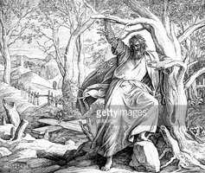
JUDAS ISCARIOT

Slide 65
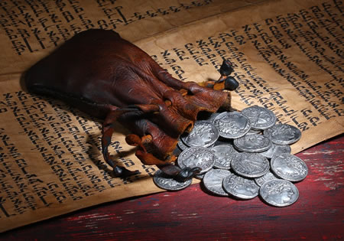
JUDAS ISCARIOT

Slide 66
JUDAS ISCARIOT
When Mary anointed Jesus and in the light of what He said about that generous act Judas Iscariot realized Jesus has virtually announced his forthcoming death and is actually willing to die. He backed Jesus till then thinking it was going to be wonderful, that he would be prominent in a prospering earthly kingdom but it dawned on Him that Jesus was going to let them kill Him. So he decided to cash in on the situation, getting out of it as much money as he can lay his hands on.

Slide 67
JUDAS ISCARIOT
The Bible makes it clear that the one reason why Judas did it was because he loved money. In the early days of their ministry Jesus sadly said to the Twelve: 'One of you is a devil'. The elders and priests probably thought afterwards they could buy out any follower of Jesus, grease their palms enough and you can buy them out.

Slide 68
JUDAS ISCARIOT
Judas had the inside information that Jesus and the disciples would stay in Jerusalem that particular night and not move out to the safety of Bethany as usual. That was why he was needed and the reason why Judas could betray Him. Judas sold the Lord for the price of a slave, a status symbol that would move him up the social scale, but that cost him his eternal salvation.

Slide 69
THE GOSPEL OF THE KINGDOM VI
'It would be wrong to translate God's Holy Word into English. Only a language like Latin or Greek is able to fully convey God's truth. English is a vulgar language only fit for farmers and shopkeepers, but not suitable for the Bible.'

Slide 70
2 Timotheus 3:12
En almal wat ook godvrugtig wil lewe in Christus Jesus, sal vervolg word.

Slide 71
Hebreers 12:1-4
Daarom dan, terwyl ons so 'n groot wolk van getuies rondom ons het, laat ons ook elke las aflê en die sonde wat ons so maklik omring, en met volharding die wedloop loop wat voor ons lê, die oog gevestig op Jesus, die Leidsman en Voleinder van die geloof, wat vir die vreugde wat Hom voorgehou is, die kruis verdra het, die skande verag het en aan die regterkant van die troon van God gaan sit het.

Slide 72
Johannes 5:35
Hy was die lamp wat brand en skyn, en julle was gewillig om julle vir ‘n tyd in sy lig te verbly.

Slide 73
THE GOSPEL OF THE KINGDOM VI
Notes:
Font: Century Gothic
Main Title Slide: Font Size 80
Main Headings: 40-44
Main Body: 33
Bold and Italic as required
Spacing: 15
Verse numbers: 20
Hebreërs
Matthéüs
Timótheüs
Korinthiërs
Efésiërs
Númeri

