Slide 1

PRACTICING PRAYER PRINCIPLES II.
Notes:
Font: Century Gothic
Main Title Slide: Font Size 80
Main Headings: 40-44
Main Body: 33
Bold and Italic as required
Spacing: 15
Verse numbers: 20
Hebreërs
Matthéüs
Timótheüs
Korinthiërs
Efésiërs
Númeri

Slide 2

‘There are parts of our gifts and callings, works of the Holy Spirit and defeats of the darkness that will come no other way than through furious, fervent, faith-filled, unceasing prayer.’ (Beth Moore)

Slide 3
‘True prayer is neither a mere mental exercise nor a vocal performance. It is far deeper than that – it is a divine spiritual transaction between us humans and the Creator of heaven and earth, God Himself’
(Charles Spurgeon)

Slide 4
‘I have been driven many times upon my knees by the overwhelming conviction that I had no where else to go. My own wisdom and that of all around me seemed insufficient for that moment and that day.’ (Abraham Lincoln)

Slide 5
‘Nothing tends more to cement the hearts of believers than praying together. Never do they love one another so well as when they witness the outpouring of each other’s hearts in heartfelt prayer.’
(Charles Finney)

Slide 6
‘Prayer is not monologue, but dialogue; God’s voice is it’s most essential part. Listening to God’s voice is the secret of the assurance that He will listen to mine.’ (Andrew Murray)

Slide 7
‘To be a Christian without prayer is no more possible than to be alive without breathing.’
(Martin Luther)

Slide 8
Lukas 18:1-8
'En Hy het ook aan hulle 'n gelykenis vertel met die oog daarop dat 'n mens gedurig moet bid en nie moedeloos word nie, en gesê: Daar was 'n regter in 'n stad wat God nie gevrees en geen mens ontsien het nie. En daar was in daardie stad 'n weduwee, en sy het gedurig na hom gekom en gesê: Doen reg aan my teenoor my teëparty.

Slide 9
Lukas 18:1-8
En 'n tyd lank wou hy nie; maar daarna het hy by homself gesê: Al vrees ek God ook nie en al ontsien ek geen mens nie, tog sal ek, omdat hierdie weduwee my moeite gee, aan haar reg doen, sodat sy nie eindelik kom en my in die gesig slaan nie. Toe sê die Here: Hoor wat die onregverdige regter sê. Sal God dan nie reg doen aan sy uitverkorenes wat dag en nag tot Hom roep nie, al is Hy ook lankmoedig in hulle geval?

Slide 10
Lukas 18:1-8
Ek sê vir julle dat Hy gou aan hulle reg sal doen; maar as die Seun van die mens kom, sal Hy wel die geloof op die aarde vind?

Slide 11
Daniel 6:1-28
Darius divided the kingdom into 120 provinces, each under a governor. The governors were accountable to three presidents (Daniel was one of them) so that the king could administer the kingdom efficiently. Daniel soon proved himself more capable than all the other presidents and governors, for he had great ability, and the king began to think of placing him over the entire empire as his administrative officer.

Slide 12
Daniel 6:1-28
This made the other presidents and governors very jealous, and they began searching for some fault in the way Daniel was handling his affairs so that they could complain to the king about him.

Slide 13
Daniel 6:1-28
But they couldn’t find anything to criticize! He was faithful and honest, and made no mistakes. So they concluded, ‘Our only chance is his religion!’ They decided to go to the king and say ‘King Darius, live forever! We presidents, governors, counsellors and deputies have unanimously decided that you should make a law, irrevocable under any circumstance, that for the next thirty days anyone who asks a favor of God or man – except from you, Your Majesty – shall be thrown to the lions.

Slide 14
Daniel 6:1-28
Your Majesty, we request your signature on this law; sign it so that it cannot be cancelled or changed; it will be a law of the Medes and Persians that cannot be revoked.

Slide 15
Daniel 6:1-28
So King Darius signed the law. But though Daniel knew about it, he went home and knelt down as usual in his upstairs bedroom, with it’s windows open toward Jerusalem, and prayed three times a day, just as he always had, giving thanks to his God. Then the men thronged to Daniel’s house and found him praying there, asking favors of his God.

Slide 16
Daniel 6:1-28
They rushed back to the king and reminded him about his law. Haven’t you signed a decree, they said, that permits no petitions to any God or man – except you – for thirty days? And anyone disobeying will be thrown to the lions? Yes, the king replied, it is a law of the Medes and the Persians, that cannot be altered or revoked.

Slide 17
Daniel 6:1-28
Then they told the king, That fellow Daniel, one of the Jewish captives, is paying no attention to you or your law. He is asking favors of his God three times a day. Hearing this, the king was very angry with himself for signing the law, and determined to save Daniel. He spent the rest of the day trying to think of some way to get Daniel out of this predicament.

Slide 18
Daniel 6:1-28
In the evening the men came again to the king and said, Your Majesty, there is nothing you can do. You signed the law and it cannot be changed. So at last the king gave the order for Daniel’s arrest, and he was taken to the den of lions.

Slide 19
Daniel 6:1-28
The king said to him, May your God, whom you worship continually, deliver you. And then they threw him in. A stone was brought and placed over the mouth of the den; and the king sealed it with his own signet ring, and that of his government, so that no one could rescue Daniel from the lions. Then the king returned to his palace and went to bed without dinner. He refused his usual entertainment and didn’t sleep all night.

Slide 20
Daniel 6:1-28
Very early the next morning he hurried out to the lions’ den, and called out in anguish, O Daniel, servant of the Living God, was your God, whom you worship continually, able to deliver you from the lions? Then he heard a voice! Your Majesty, live forever! It was Daniel! My God has sent his angel, he said, to shut the lions’ mouths so that they can’t touch me; for I am innocent before God, nor, sir, have I wronged you. The king was beside himself with joy and ordered that Daniel be lifted from the den. And not a scratch was found on him, because he believed in his God.

Slide 21
Daniel 6:1-28
Then the king issued a command to bring the men who had accused Daniel, and throw them into the den along with their children and wives, and the lions leaped upon them and tore them apart before they even hit the bottom of the den.

Slide 22
Daniel 6:1-28
Afterward King Darius wrote this message addressed to everyone in his empire: Greetings! I decree that everyone shall tremble and fear before the God of Daniel in every part of my kingdom. For his God is the living, unchanging God whose kingdom shall never be destroyed and whose power shall never end. He delivers his people, preserving them from harm; he does great miracles in heaven and earth; it is he who delivered Daniel from the power of the lions. So Daniel prospered in the reign of Darius, and in the reign of Cyrus the Persian.

Slide 23
Matthew 6:5-8
And when you pray do not be like the hypocrites, for they love to pray standing in the synagogues and on the street corners to be seen by men. I tell you the truth, they have received their reward in full. But when you pray, go into your room, close the door and pray to your Father, who is unseen. Then your Father, who sees what is done in secret, will reward you.

Slide 24
Matthew 6:5-8
And when you pray, do not keep on babbling like pagans, for they think they will be heard because of their many words. Do not be like them, for your Father knows what you need before you ask him. This then is how you should pray...

Slide 25
#1, PERSOONLIKE GEBED is 'n SKILD waaronder ons SKUIL.
Ps 91:1-4. ‘He who dwells in the secret place of the Most High shall remain stable and fixed under the shadow of the Almighty [Whose power no enemy can withstand]. I will say of the Lord, He is my Refuge and my Fortress, my God; on Him I lean and rely, and in Him I [confidently] trust. For [then] He will deliver you from hidden traps and shields you from deadly dangers. He will also protect you with His wings, there you shall trust and find shelter. His truth and His faithfulness shall be your big shield as well as your small shield.’

Slide 26
#2, PERSOONLIKE GEBED is 'n SAAD wat ons SAAI.
Ps 126:5-6. ‘Those who sow in tears shall reap with songs of joy. He who continually goes out weeping, carrying a bag of seed for sowing shall doubtless return with shouts of joy bringing his sheaves (harvest) with him.’

Slide 27
#2, PERSOONLIKE GEBED is 'n SAAD wat ons SAAI.
Gal 6:7-8. ‘Do not be deceived; God will not be mocked. For whatever a man sows, that and that only is what he will reap. The one who sows on the field of his own sinful lower nature will reap from that death and decay, but the one who sows on the field of the Spirit will reap from the Spirit life eternal. Let us then not become tired in doing good, because at the right time we will reap a harvest if we do not give up.’

Slide 28
#3, PERSOONLIKE GEBED is 'n SWAARD wat ons SWAAI.
Efe 6:11, 13 & 16-18. ‘Therefore put on God’s complete armor, that you may be able to resist and stand your ground on the evil day [of danger], and, having done all [the crisis demands], to stand [firmly in your place]...

Slide 29
#3, PERSOONLIKE GEBED is 'n SWAARD wat ons SWAAI.
Lift up over all the [covering] shield of faith, upon which you can quench all the flaming arrows of the wicked enemy. And take the helmet of salvation and the sword that the Spirit wields, which is the Word of God. And pray in the Spirit on all occasions with all kinds of prayers and requests. With this in mind, be spiritually alert and pray with endurance for all the saints.’

Slide 30
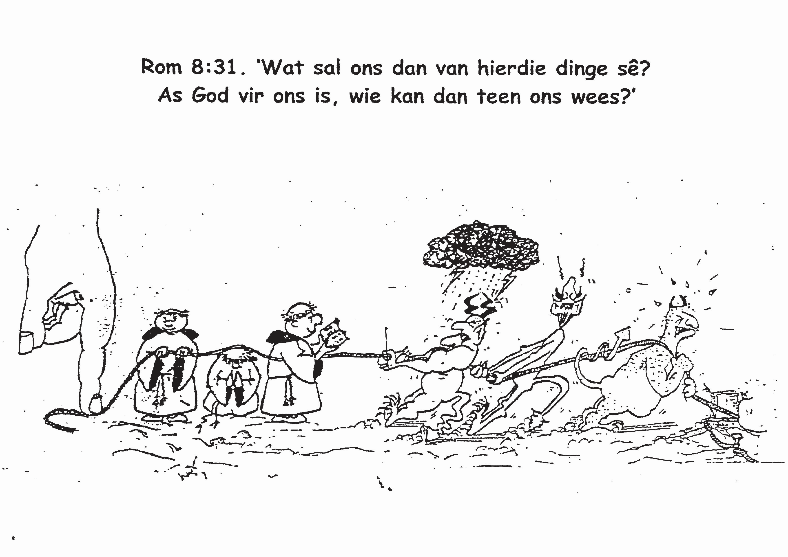

Slide 31
PRACTICING PRAYER PRINCIPLES II.
Notes:
Font: Century Gothic
Main Title Slide: Font Size 80
Main Headings: 40-44
Main Body: 33
Bold and Italic as required
Spacing: 15
Verse numbers: 20
Hebreërs
Matthéüs
Timótheüs
Korinthiërs
Efésiërs
Númeri

