Slide 1


‘One of the greatest proofs that the Bible is truly inspired by God is that it has withstood so much bad preaching.’
(A.T. Robertson)

Slide 2
BIBLE INTERPRETATION I
Notes:
Font: Century Gothic
Main Title Slide: Font Size 80
Main Headings: 40-44
Main Body: 33
Bold and Italic as required
Spacing: 15
Verse numbers: 20
Hebreërs
Matthéüs
Timótheüs
Korinthiërs
Efésiërs
Númeri

Slide 3
‘I’m going to translate the Bible into German so that the girl sweeping the room with a broom could know more of the Word of God than the priest in the palace.’ (Martin Luther)

Slide 4
Handelinge 17:11
En hierdie mense was edelmoediger as dié in Thessaloníka; hulle het die woord met alle welwillendheid ontvang en elke dag die Skrifte ondersoek of hierdie dinge so was.
‘...they received the word with all readiness, and searched the Scriptures daily to find out whether these things were so.’
‘They examined the Scriptures everyday to see if what Paul said was true.’

Slide 5
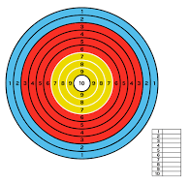

Slide 6
2 Timotheus 3:1-5.
Maar weet dit, dat daar in die laaste dae swaar tye sal kom. Want die mense sal liefhebbers van hulleself wees, geldgieriges, grootpraters, trotsaards, lasteraars, ongehoorsaam aan hulle ouers, ondankbaar, onheilig, sonder natuurlike liefde, onversoenlik, kwaadsprekers, bandeloos, wreed, sonder liefde vir die goeie, verraaiers, roekeloos, verwaand, meer liefhebbers van genot as liefhebbers van God; mense wat ‘n gedaante van godsaligheid het, mense wat ‘n gedaante van godsaligheid het, maar die krag daarvan verloën het.

Slide 7
2 Timotheus 4:1-5.
Ek besweer jou dan voor God en die Here Jesus Christus, wat die lewende en die dode sal oordeel by sy verskyning en sy koninkryk: verkondig die woord; hou aan tydig en ontydig; weerlê, bestraf, vermaan in alle lankmoedigheid en lering; want daar sal ‘n tyd wees wanneer hulle die gesonde leer nie sal verdra nie, maar, omdat hulle in hul gehoor gestreel wil wees, vir hulle ‘n menigte leraars sal versamel volgens hulle eie begeerlikhede, en die oor sal afkeer van die waarheid en hulle sal wend tot fabels.

Slide 8
‘There will be times when people will have no stomach for solid teaching, but will fill up on spiritual junk food - catchy opinions that tickle their fancy. They'll turn their backs on truth and chase after spiritual fantasy and fiction.’

Slide 9
‘Maar wees jy in alles nugter; ly verdrukking; doen die werk van ‘n evangelis; vervul jou bediening.’

Slide 10
2 Timotheus 2:15
Lê jou daarop toe om jou beproef voor God te stel as ‘n werker wat hom nie hoef te skaam nie, wat die woord van die waarheid reg sny.

Slide 11
‘Lê jou daarop toe’ beteken ‘om op spoed te kom, goed vertaal met: ‘STUDY DILIGENTLY.’
‘Beproef’ beteken aanvaarbaar voor God gemaak deur toetsing.
‘Reg sny’ beteken ‘to make a straight cut’ or PERPENDICULAR PRECISION.

Slide 12
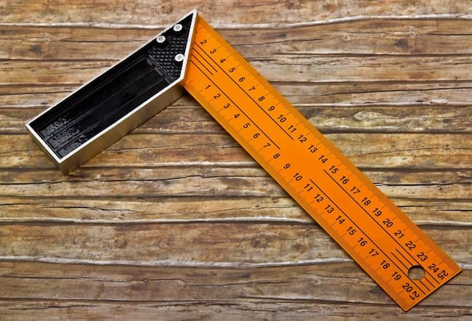

Slide 13
2 Timotheus 2:15. (AMP)
‘Study and be eager and do your utmost to present yourself to God approved (tested by trial), a workman who has no cause to be ashamed, correctly analysing and accurately dividing [rightly handling and skilfully teaching] the Word of Truth.’

Slide 14
Psalm 119: 97 & 160
Hoe lief het ek U wet; dit is my bepeinsing die hele dag. Die hele inhoud van U woord is waarheid, en al U regverdige verordeninge is tot in ewigheid.

Slide 15
The Bible is both natural and super natural, both human and divine. The Bible is divine because it is the inspired Word of God. It is God’s message to all human beings for all times. Through the Bible, God speaks to all people of all ages in all cultures. In other words it transcends time and customs. It is just as relevant for us today as it has been the last 2000 years. But the Bible is also ‘human’ in that it neither originated in a vacuum nor exists in one.

Slide 16
In the Scriptural standard God chose to speak through human beings who lived in a certain time and culture within history speaking a specific language. So God’s eternal Word was conditioned and contained within a special context and recorded by means of literature styles people could study to understand. It is this twofold nature of God’s Word that requires us to apply basic principles of interpretation to understand God’s communication to us today.

Slide 17
The Bible should be interpreted with the same rules as any other form of literature, but this does not mean that the Bible is just like any other form of literature. The Bible is unique in many ways and no other book or piece of literature is like it or can be compared with it, but the Bible’s uniqueness and inspiration doesn’t change its literary device.

Slide 18
The Holy Spirit will work to convict us of the truthfulness and significance of His Word in our lives, but to understand the literary style, genre, historical & cultural background and the meaning of words should be our task when reading the Bible. In other words, our claim of the Spirit’s guidance shouldn’t be an excuse for laziness in studying.

Slide 19
People assume that the Bible is a very mysterious book and that you need some extraordinary abilities to be able to understand it. Furthermore they assume that it contains a lot of hidden meanings or secret codes that can only be revealed and understood by an elite few.

Slide 20
While it is true that it takes more than a casual reading to understand the meaning of Biblical passages not because of some mysterious meanings but because of its divine nature, we must always remember that the Bible was originally written for everyday ordinary people in a language understood by most.

Slide 21
The New Testament letters were written for young churches, so they are simple practical instructions and teaching to be understood by every believer in the church. The goal of proper Bible interpretation is not to find ‘new revelations’ unknown to anyone before, but rather to understand the plain basic meaning of the relevant passage in its correct context.

Slide 22
Using proper rules of interpretation we should be able to distinguish between the correct and the erroneous interpretation. Bible interpretation is more than knowing a set of rules, but it cannot be done without the rules.

Slide 23
1. DIE SKRIF VERKLAAR DIE SKRIF.
SCRIPTURE interpret SCRIPTURE. SKRIF werp LIG op SKRIF.
2 Tim 3:16-17. ‘Die hele Skrif is deur God ingegee en is nuttig tot lering, tot weerlegging, tot teregwysing, tot onderwysing in die geregtigheid, sodat die man van God volkome kan wees, vir elke goeie werk volkome toegerus.’

Slide 24
BIBLE INTERPRETATION I
Notes:
Font: Century Gothic
Main Title Slide: Font Size 80
Main Headings: 40-44
Main Body: 33
Bold and Italic as required
Spacing: 15
Verse numbers: 20
Hebreërs
Matthéüs
Timótheüs
Korinthiërs
Efésiërs
Númeri

