Slide 1


John the Beloved, son of Thunder, was transported from off the isle of Patmos away from the choking marble dust of the quarry to which he was condemned, a prisoner to die, to another place in the spirit by the vehicle of visionary prophetic experience.

Slide 2
He was ‘lifted up’ to the same scene to which Isaiah had been transported out of his time and space, also by the vehicle of Spirit directed vision some eight hundred years before. One wonders if they might have been standing side by side since God is not limited or restricted by time in the same way as we are.

Slide 3
Today, for us, it is the vehicle of worship that can transport us to that miraculous and fabulous reality. We can take our place alongside the redeemed multitude singing: ‘Holy, Holy, Holy is the Lord God Almighty, Who was and is and is to come’. We can, in faith, be there and then, in the very throne room of God in awe and adoration.

Slide 4
THE LETTERS OF JESUS – SARDIS:
DYNAMIC but DYING.
Notes:
Font: Century Gothic
Main Title Slide: Font Size 80
Main Headings: 40-44
Main Body: 33
Bold and Italic as required
Spacing: 15
Verse numbers: 20
Hebreërs
Matthéüs
Timótheüs
Korinthiërs
Efésiërs
Númeri

Slide 5
All that GLITTERS is not GOLD.

Slide 6
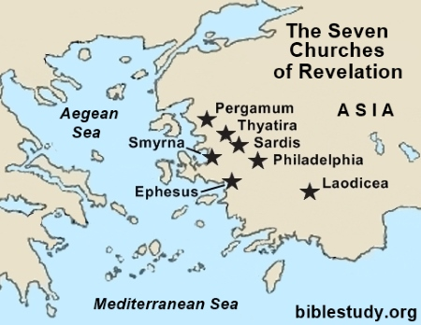

Slide 7
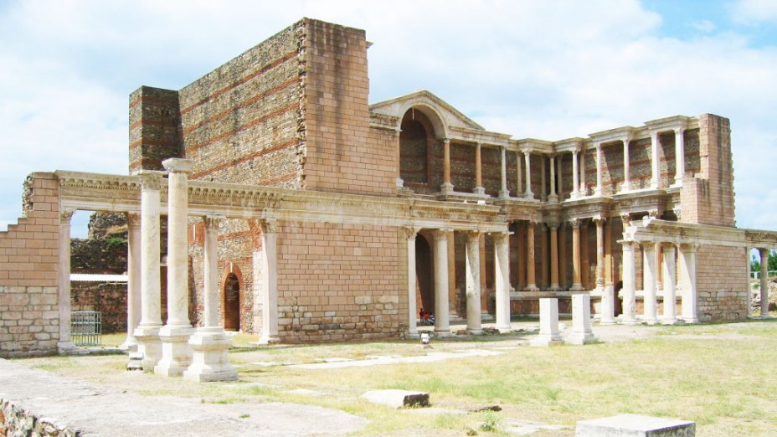

Slide 8
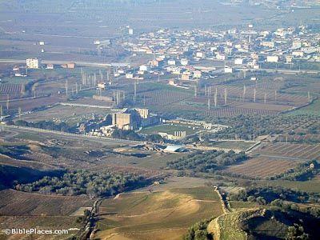

Slide 9
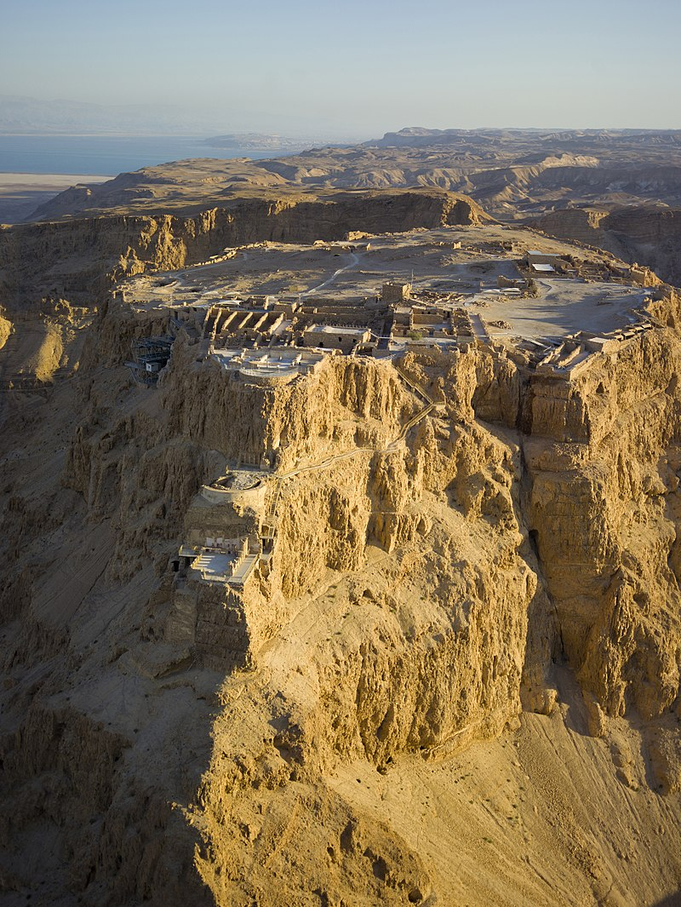

Slide 10
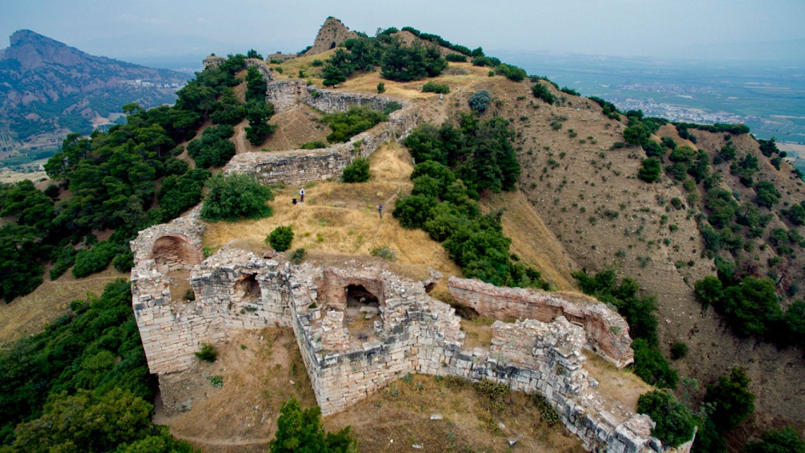

Slide 11
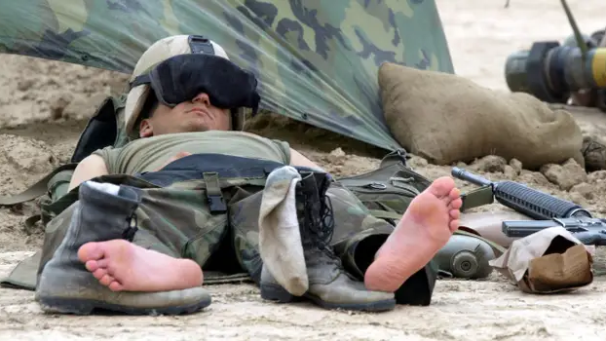

Slide 12
SARDIS ATTITUDE:
SELF-VOORSIENEND.
SELF-VERSEKERD & SELF-SUGTIG.

Slide 13
The church in SARDIS was a BUSINESS rather than a BODY, they were an ORGANIZATION rather than an ORGANISM, they had ACTIVITIES rather than ACHIEVEMENT and they had RITUAL rather than REALITY or TRUTH.

Slide 14
Openbaring 3:1-6
‘En skryf aan die engel van die gemeente in Sardis:

Slide 15
Openbaring 3:1-6
Dít sê Hy wat die sewe Geeste van God en die sewe sterre het:

Slide 16
‘En ek het gesien, en kyk, in die middel van die troon en die vier lewende wesens en in die midde van die ouderlinge staan daar ‘n Lam asof Hy geslag is, met sewe horings en sewe oë, wat die sewe Geeste van God is wat uitgestuur is oor die hele aarde.’ (Op 5:6)

Slide 17
Openbaring 3:1-6
Ek ken jou werke, dat jy die naam het dat jy leef en jy is dood.

Slide 18
‘I know your reputation as a live and active church, but you are dead. Now wake up! Strengthen what little remains – for even what is left is at the point of death. Your deeds are far from right in the sight of God.’

Slide 19
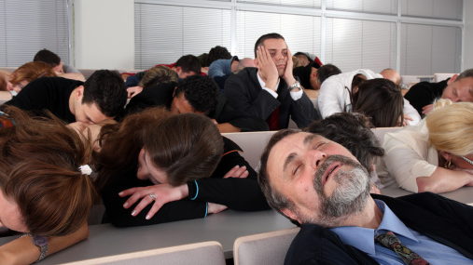

Slide 20
They were PROFESSING some sort of a creed, but not POSESSING the life of God. They had a FORM of godliness, but lacking the POWER of a godly life. They had an impressive APPEARANCE before men, but not the APPROVAL of God.

Slide 21
Openbaring 3:1-6
Wees wakker en versterk die wat oorbly, wat op die punt staan om te sterwe, want Ek het jou werke nie volkome voor God gevind nie.

Slide 22
They were honouring God with their LIPS, but not with their LIVES.

Slide 23
Openbaring 3:1-6
Onthou dan hoe jy dit ontvang en gehoor het, en bewaar dit en bekeer jou; as jy dan nie wakker word nie, sal Ek op jou afkom soos ‘n dief, en jy sal nie weet in watter uur Ek op jou afkom nie.

Slide 24
AANBEVELING: DINK terug aan die VERLEDE, KYK in die HEDE & FOKUS op die TOEKOMS.

Slide 25
Openbaring 3:1-6
Maar jy het enkele persone ook in Sardis wat hulle klere nie besoedel het nie, en hulle sal saam met My in wit klere wandel, omdat hulle dit waardig is.

Slide 26
Openbaring 3:1-6
Wie oorwin, sal beklee word met wit klere, en Ek sal sy naam nooit uitwis uit die boek van die lewe nie, en Ek sal sy naam bely voor my Vader en voor sy engele.

Slide 27
BEMOEDIGING & BELOFTES: Skoon KLERE, ‘n permanente REKORD & ‘n publieke ERKENNING.

Slide 28
Jesaja 40:31
‘…maar die wat op die Here wag kry nuwe krag, hulle vaar op met vleuels soos die arende; hulle hardloop en word nie moeg nie, hulle wandel en word nie mat nie.’

Slide 29
Lukas 10:20
‘Maar julle moenie daaroor bly wees dat die geeste aan julle onderworpe is nie, maar wees liewer bly dat julle name in die hemele opgeskrywe is.’

Slide 30
Openbaring 3:1-6
Wie ‘n oor het, laat hom hoor wat die Gees aan die gemeentes sê.’

Slide 31
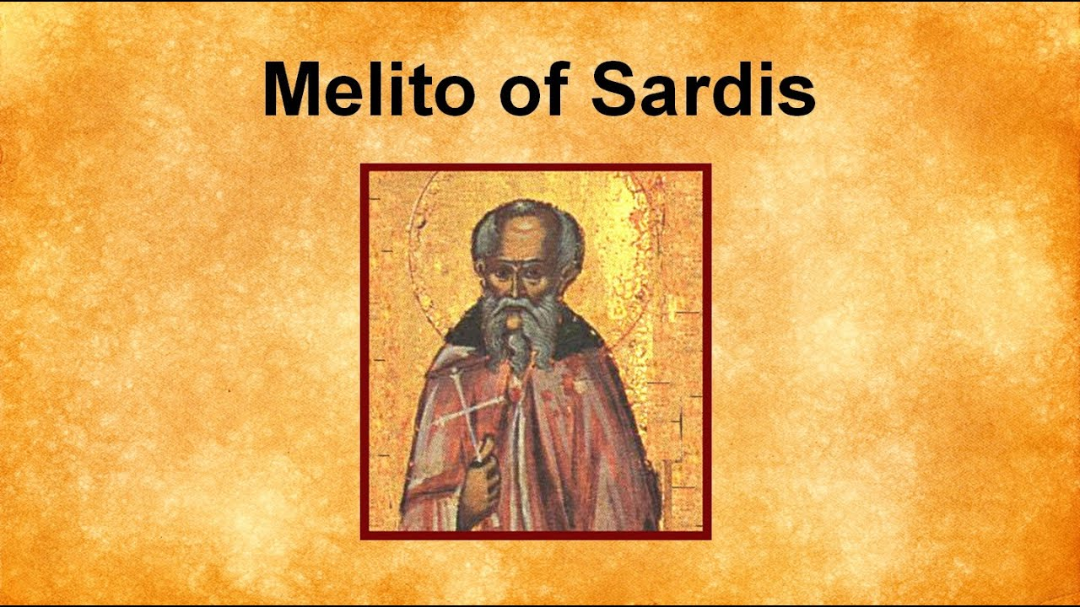

Slide 32
THE LETTERS OF JESUS – SARDIS
Notes:
Font: Century Gothic
Main Title Slide: Font Size 80
Main Headings: 40-44
Main Body: 33
Bold and Italic as required
Spacing: 15
Verse numbers: 20
Hebreërs
Matthéüs
Timótheüs
Korinthiërs
Efésiërs
Númeri

