Slide 1


‘Joseph Smith, Jr, the founder of Mormonism, or the church of Jesus Christ of Latter-Day saints, was born on December 23, 1805, in Sharon, Vermont. Smith was the fourth of ten children of Joseph & Lucy Mack Smith. In 1817 the family moved to Palmyra, New York. Most of the members of the Smith family soon joined the Presbyterian church, but young Joseph remained undecided.

Slide 2
His argument was that all the strife and tension among the various denominations made him question which denomination was right. It was this conflict that set the stage for Joseph’s alleged first vision.

Slide 3
In 1820 Joseph allegedly received a vision that became the basis for the founding of the Mormon Church. My object in going to inquire of the Lord, he said was to know which of all the sects was right, that I might know which to join. No sooner, therefore, did I get possession of myself, so as to be able to speak, than I asked the persons who stood above me in the light, which of all the churches was right.

Slide 4
I was answered that I must join none of them, for they were all wrong; and the persons who addressed me said that all their creeds were an abomination in His sight; that those who profess faith were all corrupt, that ‘they draw near to me with their lips, but their hearts are far from me...’

Slide 5
Joseph then recounts a second vision he had on September, 21, 1823, in which he claims: I had a second vision. A person appeared at my bedside who was glorious beyond description.

Slide 6
He said that he was a messenger sent from the presence of God, and that his name was Moroni, that God had a work for me to do and that my name should be for good and evil among all nations, tribes & tongues.

Slide 7
He told me that a book had been deposited, written on golden plates, giving an account of the former inhabitants of this continent and containing ‘the fullness of the everlasting Gospel’ as delivered by the Saviour to the ancient inhabitants of this land...

Slide 8
I was shown exactly where the plates had been deposited. That same night the heavenly messenger appeared again twice, each time repeating the same message...’

Slide 9
DECEPTION DANGER II.

Slide 10
#1, Agter alle desepsie sit die duiwel self.

Slide 11
#2, Alle desepsie is ‘n verbuiging van die waarheid en bevat daarom gewoonlik elemente van waarheid…

Slide 12
#3, Dat as desepsie sy volle gang gaan dit jou nie net sal vervreem van God nie, maar ook van belangrike mense in jou lewe…

Slide 13
#4, Die vyand teiken gewoonlik eerder swakker mense in die geloof met desepsie…

Slide 14
Mt 24:3-24.
‘En toe Hy op die Olyfberg gaan sit het, kom die dissipels alleen na Hom en sê: Vertel ons, wanneer sal hierdie dinge wees, en wat is die teken van u koms en van die voleinding van die wêreld? En Jesus antwoord en sê vir hulle: Pas op dat niemand julle mislei nie.’

Slide 15
Gr: Mislei: ‘plan-ah-o’ (planao). Kom van die woord vir fraudulent & false, maar ook om te veroorsaak dat iemand afdwaal & verdwaal.

Slide 16
Mt 24:3-24.
‘Want baie sal onder my Naam kom en sê: Ek is die Christus! en hulle sal baie mense mislei. En julle sal hoor van oorloë en gerugte van oorloë. Pas op, moenie verskrik word nie, want alles moet plaasvind, maar dit is nog nie die einde nie.

Slide 17
Mt 24:3-24.
Want die een nasie sal teen die ander opstaan en die een koninkryk teen die ander; en daar sal hongersnode wees en pessiektes en aardbewings op verskillende plekke. Maar al hierdie dinge is ‘n begin van die smarte.

Slide 18
Mt 24:3-24.
Dan sal hulle jul aan verdrukking oorgee en julle doodmaak; en julle sal deur al die nasies gehaat word ter wille van my Naam.’

Slide 19
Mt 24:3-24.
En dan sal baie tot struikel gebring word en mekaar verraai en mekaar haat. En baie valse profete sal opstaan en baie mense mislei.’

Slide 20
Mt 24:3-24.
‘Many false prophets shall rise and shall deceive many.’

Slide 21
Mt 24:3-24.
‘En omdat die ongeregtigheid vermeerder word, sal die liefde van die meeste verkoel. Maar wie volhard tot die einde toe, hy sal gered word. En hierdie evangelie van die koninkryk sal verkondig word in die hele wêreld tot ‘n getuienis vir al die nasies; en dan sal die einde kom.’

Slide 22
Mt 24:3-24.
‘Want dan sal daar groot verdrukking wees soos daar van die begin van die wêreld af tot nou toe nie gewees het en ook nooit sal wees nie. En as daardie dae nie verkort was nie, sou geen vlees gered word nie; maar ter wille van die uitverkorenes sal daardie dae verkort word.

Slide 23
Mt 24:3-24.
As iemand dán vir julle sê: Kyk, hier is die Christus! of: Daar! - moet dit nie glo nie. Want daar sal valse christusse en valse profete opstaan, en hulle sal groot tekens en wonders doen om, as dit moontlik was, ook die uitverkorenes te mislei.’

Slide 24
2 Thes 2:9.
‘The coming of the lawless one will be in accordance with the work of Satan displayed in all kinds of counterfeit miracles, signs and wonders, and in every sort of evil that deceives those who are perishing.’

Slide 25
#1, Weerspreek die praktyke wat gebeur of beoefen word of die lering wat gegee word die geskrewe Woord?

Slide 26
Ps 138:2.
‘For You have exalted Your word above all Your name.’

Slide 27
#2, Is daar ‘n fokus op bekering & ‘n konstante oproep tot heiligmaking?

Slide 28
#3, Staan Jesus sentraal tot alles?

Slide 29
#4, Vervreem dit verhoudings tussen mense wat vroeër selfs goeie vriende was?

Slide 30
#5, Is daar hoogmoed & arrogansie teenwoordig?

Slide 31
#6, Is daar ‘n oordrewe fokus op finansies?

Slide 32
#7, Isolasie & Eksklusiwiteit…

Slide 33
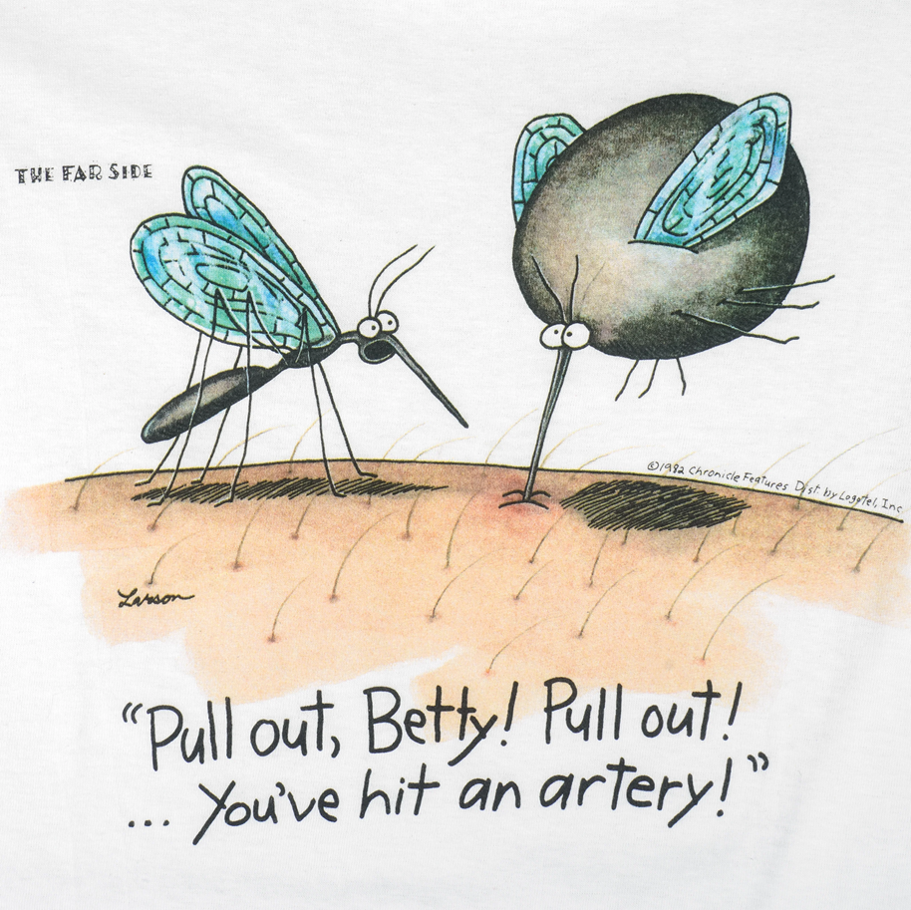

Slide 34
’They perish because they refused to love the truth and so be saved. For this reason God sends them a powerful delusion so that they will believe the lie and so that all will be condemned who have not believed the truth but have delighted in wickedness.’ (2 Thes 2:10-12)

Slide 35
1 Kor 15:33.
‘Moenie dwaal nie; slegte gesprekke bederf goeie sedes.’

Slide 36
‘Do not be deceived: Bad company corrupts good character.’

Slide 37
Gr: sedes: ‘ay-thos’ (ethos) Morele waardes, Etiek.

Slide 38
‘Want ek weet dit, dat ná my vertrek wrede wolwe onder julle sal inkom en die kudde nie sal spaar nie.’ (Hd 20:29)

Slide 39
‘Ja, uit julle self sal daar manne opstaan wat verkeerde dinge praat om die dissipels weg te trek agter hulle aan.’ (Hd 20:30)

Slide 40
Gr: verkeerde dinge: ‘dee-as-tref-o’ (diastrepho) Beteken ‘n perverse distorsie of misinterpretasie. Misleiding.

Slide 41
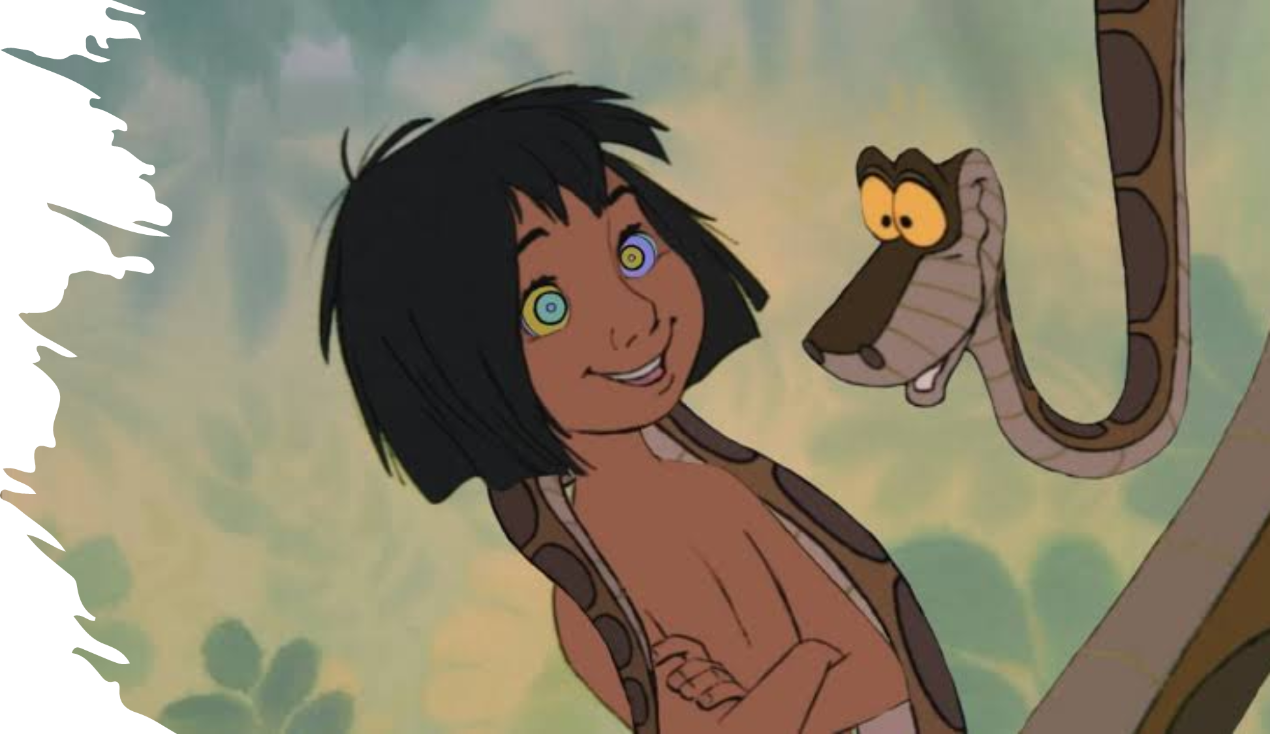

Slide 42
DECEPTION DANGER II.

