Slide 1


Farmer Joe was in his car just outside Corinth when he was hit by a truck. He decided his injuries from the accident were serious enough to take the trucking company (responsible for the accident) to court.

Slide 2
In court the trucking company’s fancy local lawyer was questioning farmer Joe. “Didn’t you say, at the scene of the accident, ‘I’m fine’?” said the lawyer.

Slide 3
Farmer Joe responded, “Well I’ll tell you what happened. I had just loaded my favourite mule Bessie into the….” “I didn’t ask for any details,” the lawyer interrupted, “just answer the question. Did you not say, at the scene of the accident, ‘I’m fine’?!’

Slide 4
Farmer Joe said, “Well I had just got Bessie into the trailer and I was driving down the road….” The lawyer interrupted again and said, “Judge, I am trying to establish the fact that, at the scene of the accident, this man told the Police Officer on the scene that he was just fine.

Slide 5
Now several weeks after the accident he is trying to sue my client. I believe he is a fraud. Please tell him to simply answer the question.”

Slide 6
By this time the Judge was fairly interested in Farmer Joe’s answer and said to the lawyer, “I’d like to hear what he has to say about his favourite mule Bessie.”

Slide 7
Joe thanked the Judge and proceeded, “Well as I was saying, I had just loaded Bessie, my favourite mule, into the trailer and was driving her down the highway when this huge semi-truck and trailer ran the stop sign and smacked my truck right in the side. I was thrown into one ditch and Bessie was thrown into the other.

Slide 8
“I was hurting real bad and didn’t want to move. However, I could hear old Bessie moaning and groaning. I knew she was in terribly hurt just by these noises.

Slide 9
“Shortly after the accident a Traffic Officer came on the scene. He could hear Bessie moaning and groaning so he went over to her. After he looked at her, he took out his gun and shot her between the eyes.

Slide 10
“Then the Officer came across the road with his gun in his hand and looked at me. He said, “Your mule was in such bad shape I had to shoot her. How are you feeling?”

Slide 11
KERK DISSIPLIENE is ‘n proses wat oor tyd opwerk van PRIVATE & SAGTE GESPREKKE na meer PUBLIEKE & HARDE GRENSE.

Slide 12
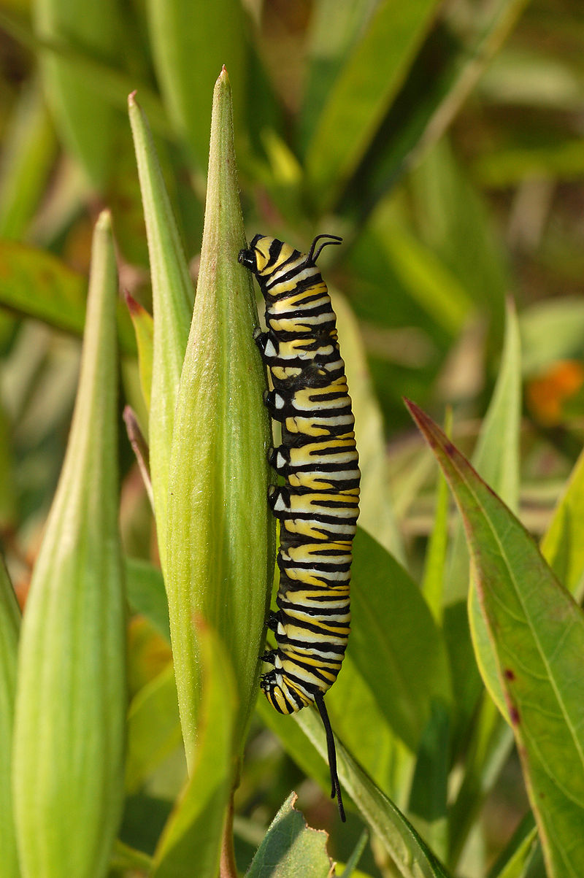

CORINTHIANS – WILD & WONDERFUL IV.

Slide 13
‘Want die liggaamlike oefening is tot weinig nut, maar die godsaligheid is nuttig vir alles, omdat dit die belofte van die teenwoordige en die toekomende lewe het.’ (1 Tim 4:8)

Slide 14
‘Bodily exercise is all right, but spiritual exercise is much more important and is a tonic for all you do. So exercise yourself spiritually and practice becoming a better Christian, because that will help you not only now in this life, but in the next life too.’

Slide 15
1 Kor 6:1-20.
‘Durf iemand van julle wat ‘n saak teen ‘n ander het, gaan reg soek voor die onregverdiges en nie voor die heiliges nie?

Slide 16
1 Kor 6:1-20.
Weet julle nie dat die heiliges die wêreld sal oordeel nie?

Slide 17
Dan 7:21-22.
‘Ek het gesien dat hierdie horing oorlog voer met die heiliges en hulle oorwin, totdat die Oue van dae kom en aan die heiliges van die Allerhoogste reg verskaf is en die bepaalde tyd gekom het dat die heiliges die koninkryk in besit geneem het.’

Slide 18
1 Kor 6:1-20.
’En as die wêreld deur julle geoordeel word, is julle dan onbevoeg vir die geringste regsake?

Slide 19
1 Kor 6:1-20.
Weet julle nie dat ons engele sal oordeel nie, hoeveel te meer die alledaagse dinge?

Slide 20
2 Pt 2:4 & 9.
‘Want as God die engele wat gesondig het, nie gespaar het nie, maar hulle in die hel gewerp en aan kettings van duisternis oorgegee het, om vir die oordeel in bewaring gehou te word;…

Slide 21
2 Pt 2:4 & 9.
’…die Here weet om die godsaliges uit versoeking te verlos en die onregverdiges te bewaar vir die dag van oordeel om gestraf te word;…’

Slide 22
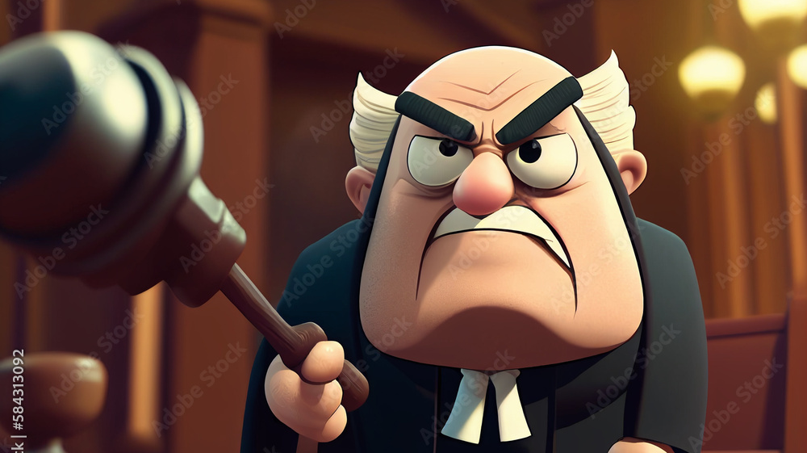

Slide 23
1 Kor 6:1-20.
‘As julle dan alledaagse regsake het, moet julle dié persone daaroor laat sit wat in die gemeente die minste geag word.

Slide 24
1 Kor 6:1-20.
Ek sê dit tot julle beskaming.

Slide 25
1 Kor 6:1-20.
Is daar dan nie eens een wyse onder julle, wat uitspraak sal kan doen tussen sy broeders nie? Maar gaan die een broeder met die ander na die regbank, en dit voor ongelowiges?

Slide 26
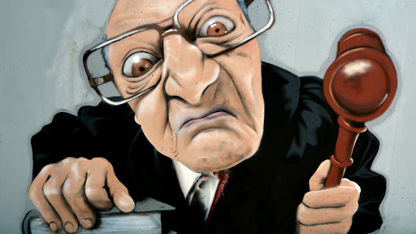

Slide 27
1 Kor 6:1-20.
Dan is dit al werklik ‘n gebrek onder julle, dat julle regsake met mekaar het. Waarom ly julle nie liewer onreg nie? Waarom laat julle jul nie liewer berowe nie?

Slide 28
Spr 20:22.
‘Moenie sê: Ek wil die kwaad vergelde nie! Wag op die HERE, dat Hy jou help.’

Slide 29
‘Don’t repay evil for evil. Wait for the Lord to handle the matter.’

Slide 30
1 Kor 6:1-20.
Maar julle doen onreg en pleeg roof, en dit aan broeders.

Slide 31
1 Kor 6:1-20.
Of weet julle nie dat die onregverdiges die koninkryk van God nie sal beërwe nie?

Slide 32
‘And how dare you take each other to court! When you think you have been wronged, does it make any sense to go before a court that knows nothing of God’s ways instead of a family of Christians?

Slide 33
The day is coming when the world is going to stand before a jury made up of followers of Jesus. If someday you are going to rule on the world’s fate, wouldn’t it be a good idea to practice on some of these smaller cases?

Slide 34
Why, we’re even going to judge angels! So why not these everyday affairs? As these disagreements and wrongs surface, why would you ever entrust them to the judgment of people you don’t trust in any other way?

Slide 35
I say this as bluntly as I can to wake you up to the stupidity of what you’re doing. Is it possible that there isn’t one level-headed person among you who can make fair decisions when disagreements and disputes come up? I don’t believe it.

Slide 36
And here you are taking each other to court before people who don’t even believe in God! How can they render justice if they don’t believe in the God of justice?

Slide 37
These court cases are a black eye on your church community. Wouldn’t it be far better to just take it, to let yourselves be wronged and forget it? All you’re doing is providing fuel for more wrong, more injustice, bringing more hurt to the people of your own spiritual family.

Slide 38
Vir die Kerk is ‘n goeie KONSULTASIE baie maal ‘n goeie VERWYSING…

Slide 39
Mediation is a process wherein the parties meet with a mutually selected impartial and neutral person who assists them in the negotiation of their differences…

Slide 40
Arbitration is a procedure in which a dispute is submitted, by agreement of the parties, to one or more arbitrators who make a binding and legal decision on the dispute…

Slide 41
In other words a process in which an independent person makes an official decision that ends a legal disagreement without the need for it to be solved in court…

Slide 42
1 Kor 6:1-20.
‘Moenie dwaal nie! Geen hoereerders of afgodedienaars of egbrekers of wellustelinge of sodomiete…

Slide 43
‘nor those who participate in homosexuality’

Slide 44
‘mense wat homoseksualiteit beoefen’

Slide 45
Gr: ‘malakos’ A catamite is a boy or male person kept for homosexual practices as the passive or receiving partner in anal intercourse

Slide 46
Gr: ‘arsenokoites’ Sodomites: Men who engage sexually with other men or with animals including and by implication lesbian behaviour.

Slide 47
Gen 13:13.
‘En die manne van Sodom was sleg en groot sondaars voor die HERE.’

Slide 48
1 Kor 6:1-20.
…of diewe of gierigaards of dronkaards of kwaadsprekers of rowers sal die koninkryk van God beërwe nie.

Slide 49
1 Kor 6:1-20.
En dit was sommige van julle;… (For such were some of you)

Slide 50
1 Kor 6:1-20.
En dit was sommige van julle; maar julle het jul laat afwas, maar julle is geheilig, maar julle is geregverdig in die Naam van die Here Jesus en deur die Gees van onse God.’

Slide 51
CORINTHIANS – WILD & WONDERFUL IV.

